Slide 1
RSPT 2335
MODULE A
AIRWAY MANAGEMENT
INTRODUCTION
&
Part 1
Pharyngeal, Laryngeal & Esophageal Airways

Slide 2
Parts of Module A AIRWAY MANAGEMENT
Part 1 – Pharyngeal, Laryngeal & Esophageal Airways
Part 2 – Tracheal Airways
Part 3 – Airway Clearance
Part 4 - Advanced Airways
Part 5 - Airway Complications & Emergencies

Slide 3
ASSIGNMENTS MODULE A
Reading:
Egan’s Fundamentals of RC:
Chapter 33 – 746-747, 754-756, 760-764, 767-779

Slide 4
ASSIGNMENTS
Laboratory Work:
Butler
22.2.3 – Intubation with an ETC airway in place
22.3 – Securing an ET tube
22.2.5 – Nasotracheal intubation
23.2.3 – Tracheostomy tube decannulation
24.2 – Resecuring and repositioning of an endotracheal tube and oral hygiene
24.3 – Extubation
24.4 – Airway emergencies

Slide 5
RESOURCES
AARC-Clinical Practice Guidelines:
“These AARC’s guidelines enhance respiratory practice and provide a framework for RT protocols. “
Endotracheal Suctioning of Mechanically Ventilated Patients with Artificial Airways (revised 2010)
Nasotracheal Suctioning
Removal of the Endotracheal Tube (revised 2007)
Bronchoscopy Assisting

Slide 6
RESOURCES
Other Guidelines:
ASA - Practice Guidelines for Management of the Difficult Airway

Slide 7
OBJECTIVES
At the end of this module, the student should be able to…
identify the different laryngeal & esophageal airways , their components and accessories.
list the indications, contraindications, hazards & complications of these airways.
list the advantages and disadvantages of the these airways.

Slide 8
OBJECTIVES
At the end of this module, the student should be able to…
demonstrate the ability to determine the proper size airway for a patient.
demonstrate the ability to insert, check proper placement and secure these airways.
demonstrate the ability to perform airway maintenance.

Slide 9
OBJECTIVES
At the end of this module, the student should be able to…
explain the proper procedure for removal of the these airways.
given a problem scenario, describe the proper procedures for handling the situation.

Slide 10
Major Topics
Laryngeal Airways
Esophageal Airways

Slide 11
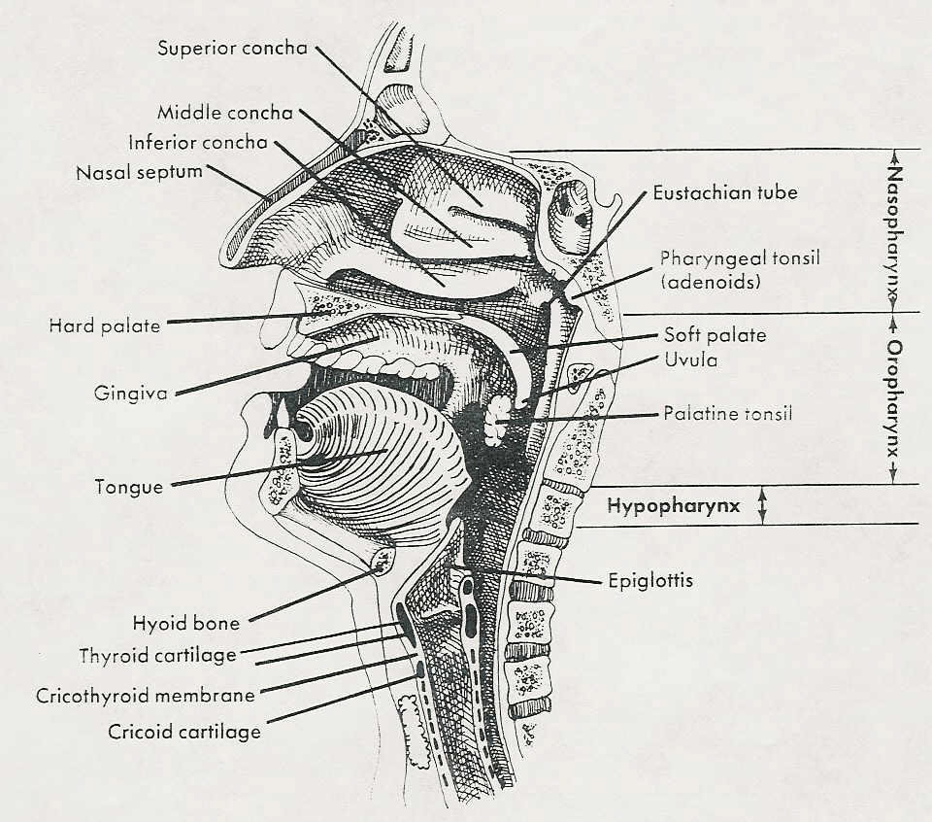
Airway Placement:
Oral Pharynx
Nasal Pharynx
Larynx
Isolation (esophageal)
Orotracheal
Nasotracheal
Tracheal

Slide 12
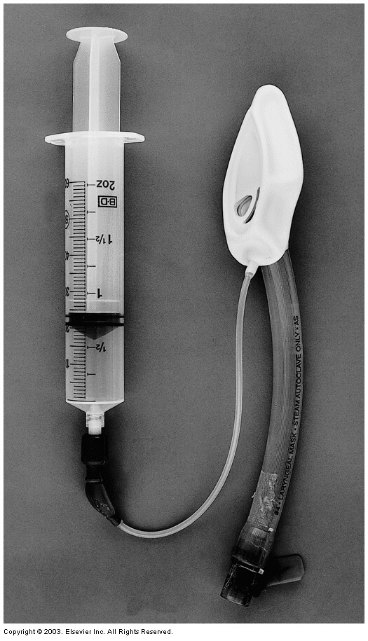
Laryngeal Airway Devices (Supralaryngeal)
Laryngeal Mask Airway
(LMA)

Slide 13
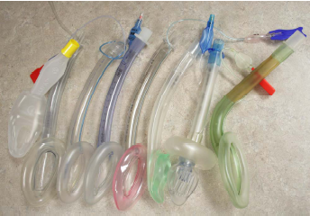

Slide 14
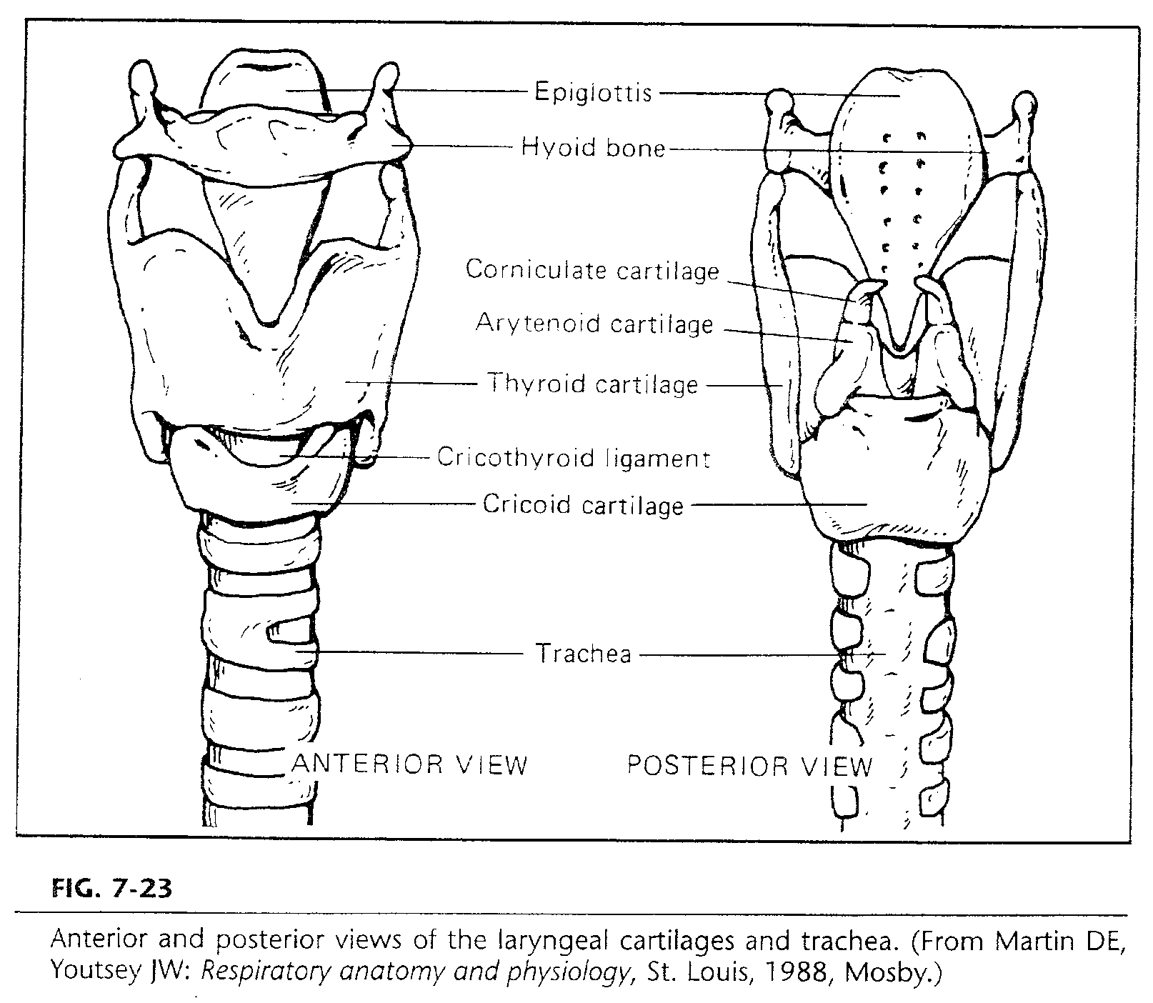
B. Anatomy

Slide 15
Airway Placement:
Oral Pharynx
Nasal Pharynx
Larynx
Isolation (esophageal)
Orotracheal
Nasotracheal
Tracheal

Slide 16
Laryngeal Mask Airway (LMA)
Most common uses in U.S. since 1991:
Popular in Operating Rooms especially for difficult intubations or short surgeries (ambulatory anesthesia)
Use in Emergency Department especially for difficult or failed intubations
Option for difficult intubation and airway management
Some success with surfactant administration in neonates

Slide 17
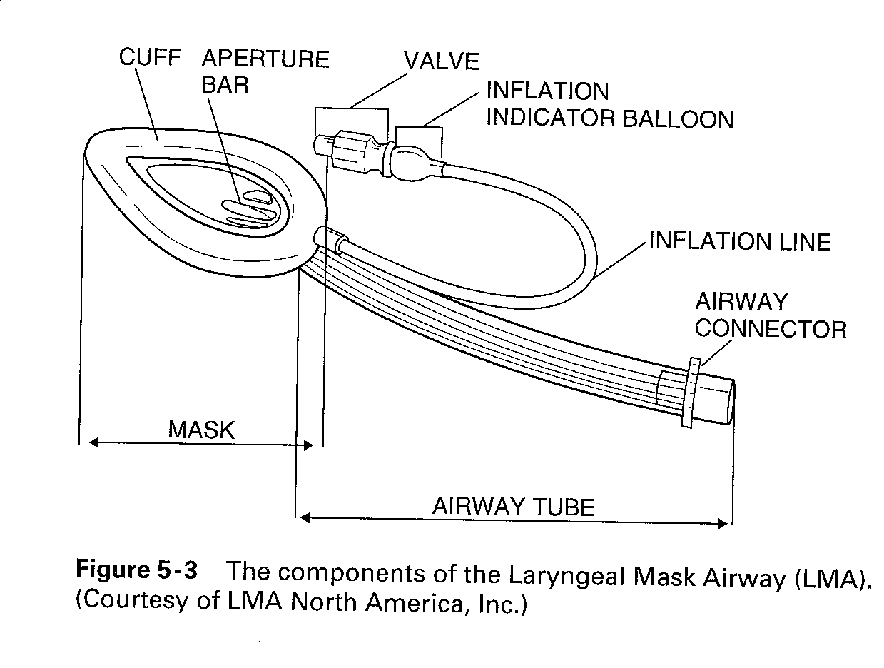

Slide 18
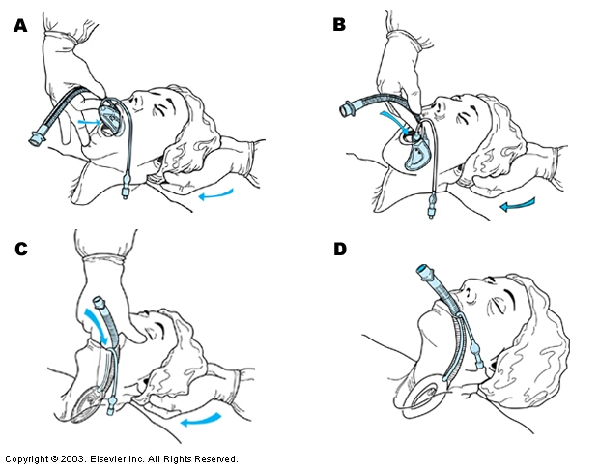
Egan pg. 778 Fig. 33-38 Laryngeal mask airway

Slide 19
Insertion – (LMA)
Be sure the cuff is deflated and then lubricate the posterior surface of the airway only.
Do not use anesthetic sprays in the airway.
The unconscious patient is placed in the sniffing position
A conscious patient should have some form of sedation (similar to endotracheal intubation)

Slide 20
Insertion – (LMA)
The jaw is held open and the mask and cuff are advanced along the hard palate
Some may be inserted without putting finders into the mouth
Others require using the index finger to move the mask into position at the back of the tongue in the esophageal sphincter.
The tube is advanced until resistance is felt as the mask settles over the esophagus and larynx.

Slide 21
Insertion – (LMA)
The cuff is inflated around the laryngeal opening
There may be a small swelling noted at the level of the cricoid cartilage in the neck.
Inflation pressure may reach 60 cmH2O
Fill until the pilot balloon is firm but not hard.
Inflation volume varies with LMA size and patient anatomy (4 – 50 mL)

Slide 22
Troubleshooting– (LMA)
What if I insert the LMA, inflate the cuff and there is still a leak?
Verify the proper LMA size
Verify the correct amount of air was used to inflate the cuff (to much and too little can cause leaks
Deflate the cuff, reposition the LMA and re-inflate
Flex the patient’s neck 10 – 20 degrees
Verify that the ventilating pressures do not exceed to pressure limit of the LMA (usually 20 cmH2O)
Change to pressure control ventilation (handles leaks better)
Ensure the patient is properly sedated/anesthetized or unconscious

Slide 23
Laryngeal Mask Airway (LMA)
Advantages
Placed blindly - Quick with no additional equipment needed
Low pressure seal around glottis may cause less trauma than endotracheal intubation.
Spontaneous breathing is possible.
An endotracheal tube may be inserted directly into the trachea through some LMAs.

Slide 26
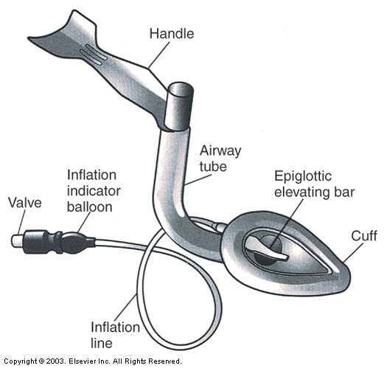
Egan Fig. 33-38
Intubating laryngeal mask airway.

Slide 27
Laryngeal Mask Airway (LMA)
Contraindications
Conscious or semi-conscious patients (non-sedated)
Patients with high risk of aspiration
Removal
The airway can be removed when the patient is alert enough to open their mouth on command.

Slide 28
Laryngeal Mask Airway (LMA)
Disadvantages
It does not reliably prevent aspiration.
May stimulate gag reflex or laryngospasm.
High pressure assisted ventilation may cause gastric insufflation.
Usually used with ventilating pressures of 20 cm H₂O or less. (Pro-seal up to 30 cm H₂O)

Slide 30
Reusable LMA
May be reused up to 40 times
Better have a good tracking system needed!
Processing:
Clean with appropriate solution
Endozyme, 1:10 baking soda & water, mild detergent
Rinse & inspect
Dry & deflate cuff
Package
Sterilize by Steam Autoclave only
Check performance before next use

Slide 31
Esophageal (Isolation) Airways

Slide 32
Esophageal Airway (Isolation) Devices
Esophageal Tracheal Combitube (ETC) (Double-lumen)
King Airway

Slide 33
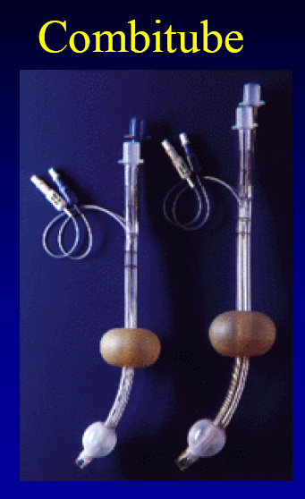
Available in two adult sizes based on height
Combitube SA (small adult)
4 – 5.5 feet tall
And
Combitube
5 feet and over

Slide 34
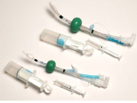
Comes packaged with two syringes
20 mL & 140 mL

Slide 35
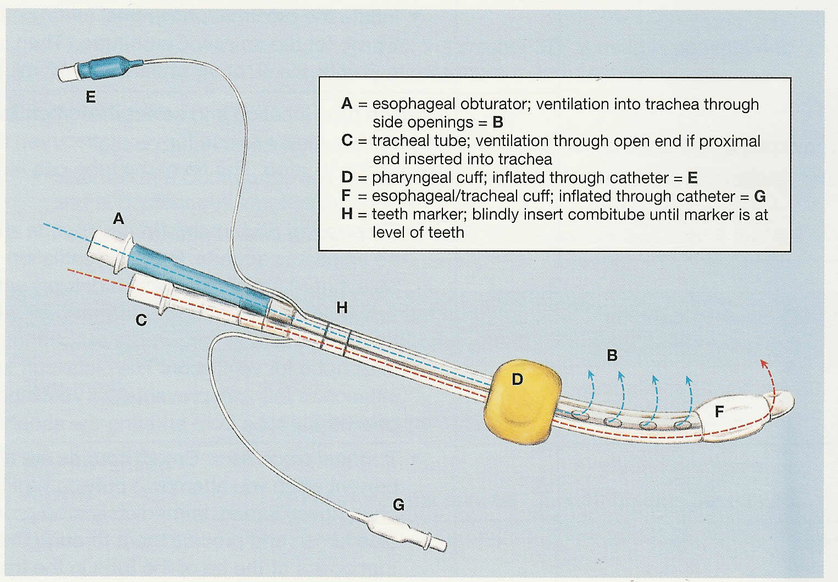

Slide 36
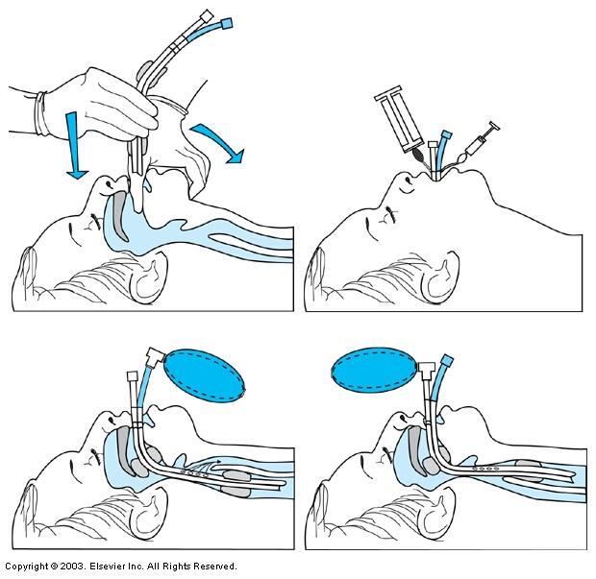
Egan pg. 779
Fig. 33-40 Insertion of the Combitube.
Esophageal placement
Tracheal placement

Slide 37
Esophageal Tracheal Combitube (ETC)
Uses in U.S. since 1988:
for adult victims
unresponsive without gag reflex
popular on EMS transports when intubation is not possible or permitted
patients may enter ED with device
may be used for difficult airway management

Slide 38
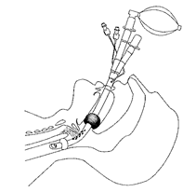
Insertion
The jaw is held open and the tube is advanced along the hard palate until teeth are between reference marks
It may be placed into the esophagus or the trachea.
Do not force – if resistance is met; redirect or withdraw and reinsert.

Slide 39
Insertion
Cuffs are inflated with syringes
Proximal Blue #1 with 85 - 100 mL air (140 mL syringe)
Distal White #2 with 10 - 15 mL air (20 mL syringe)
Attempt ventilation through longer tube first
If negative - then try shorter tube
If negative – then deflate cuffs and adjust depth (pull back 1 – 2 cm)

Slide 40
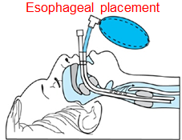
Esophageal placement
(most likely)
Both cuffs remain inflated
The bag is attached to long blue port #1
gas will move through the side hole on the lower tube and into the lungs
Second tube can be used for gastric suction
If long-term ventilation is needed:
May intubate before removing ETC

Slide 41
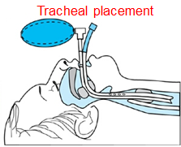
Tracheal intubation:
only the lower cuff needs to remain inflated
the bag is attached to shorter white port #2.
Deflate larger balloon if desired
If long-term ventilation is needed:
May remove to intubate
May use tube exchanger or bougie for intubation

Slide 42
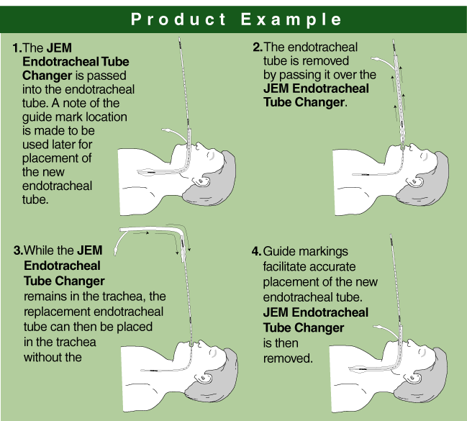
Tube Changer
(exchanger)

Slide 43
ETC
Removal of ETC
remove if patient is capable of sustaining spontaneous respirations on their own
If long-term ventilation is needed
Contraindications –
Not for use with esophageal trauma or disease, corrosive ingestion, pharyngeal trauma.
Positive gag reflex

Slide 44
ETC
Advantages
Blind placement (95% in esophagus)
High ventilation pressures possible
Ability to suction stomach (with esophageal placement)
Spontaneous breathing is possible.
There is no concern about head position or mask seal.

Slide 45
ETC
Advantages
Pharyngeal balloon is self-adjusting and self positioning.
If in the esophagus, it does not stimulate the larynx so spasm of the vocal cords is not a problem.
Does not require laryngoscope to insert.
Can be placed in esophagus or trachea and still be useful.

Slide 46
ETC
Disadvantages
May cause esophageal perforation.
Could cause same complications as an endotracheal tube.
Must use caution to keep cuffs in place and inflated properly.
Must be sure to bag through the appropriate port.

Slide 47
Replacing ETC in Esophagus
Insert the ET
Ventilate the patient and verify ET placement
Inflate ET cuff
Hold the ET, deflate ETC lower cuff and remove
Secure ET and check cuff pressure
1. Prepare equipment
resuscitation bag & mask
Intubation
Suctioning
Prepare the patient
Inform
Position
Suction ETC & upper airway
Deflate the upper cuff

Slide 48
Replacing ETC in Trachea
Perform the “Cuff Leak Test”
Insert a “Tube Exchanger”
Remove the ETC
Insert the ET tube
Remove the tube exchanger
Ventilate, verify tube placement & secure
1. Prepare equipment
resuscitation bag & mask
Intubation
Tube exchanger
Suctioning
Prepare the patient
Inform
Position
Suction ETC & oral airway
Deflate the cuff(s)

Slide 49
King Airway

Slide 50
King Airways
LTS-D
LTS
LT-D
D=disposible

Slide 51
KING LT-D
Placement into the esophagus
Two cuffs:
One cuff smaller lower cuff prevents gastric distension
Larger upper cuff seals upper airway
Gastric tube cannot be passed for decompression
Cannot intubate using tube exchanger

Slide 52
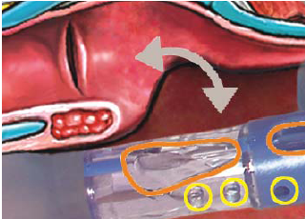
Ventilation Ports

Slide 54
LT-D Insertion Videos
http://www.youtube.com/watch?v=eJix_gZW5OA&feature=related
http://www.youtube.com/watch?v=ca710sG4-ck

Slide 55
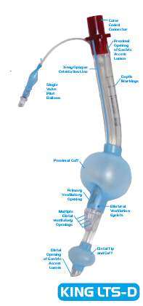
KING LTS-D
Placement into the esophagus
Two cuffs:
One cuff smaller lower cuff prevents gastric distension
Larger upper cuff seals upper airway
Gastric tube can be passed for decompression
Can intubate using tube exchanger
NOTE: King LTS is Reusable up to 50 times

Slide 56
Sizes
Yellow
4 – 5 feet tall
45 - 60 mL air in cuff
Red
5 – 6 feet tall
60 – 80 mL air in cuff
Purple
Over 6 feet tall
70 – 90 mL air in cuff

Slide 57
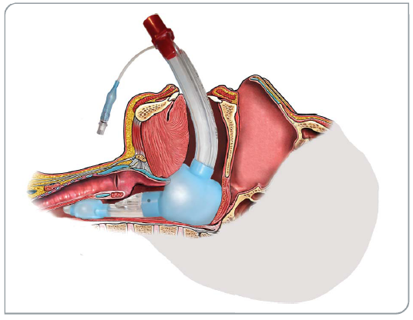
King LTS-D in place

Slide 58
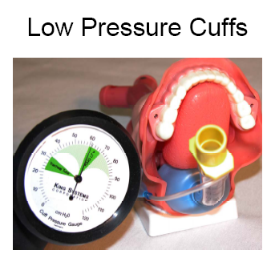

Slide 59
Advantages
Easy insertion
Esophageal placement only
Single inflation line for both cuffs
Single ventilation connection
Good ventilatory seal for pressures > 30cmH2O
Airway exchange possible
Easy access to stomach (LTS-D)

Slide 61
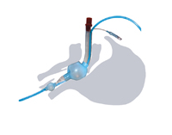
King LTS-D
Gastric tube in place

Slide 63
NG Tube Insertion Procedure

Slide 64
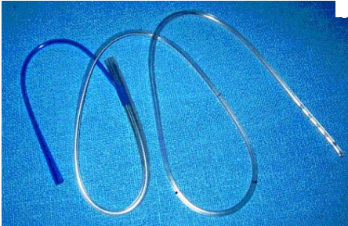
NG Tube

Slide 65
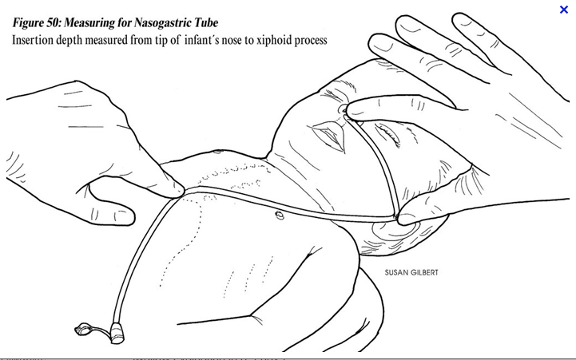
Measuring Length of an NG Tube

Slide 66
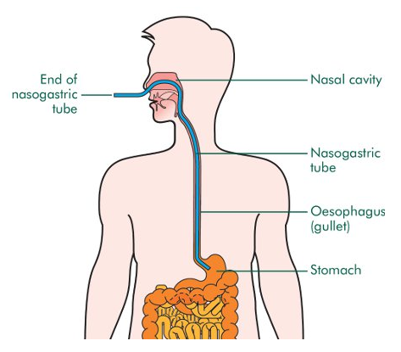
NG Tube Placement

Slide 67
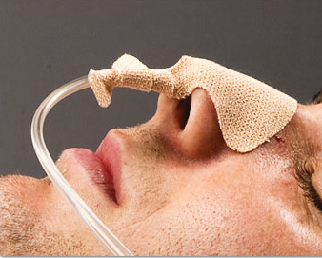
Securing an NG

Slide 68
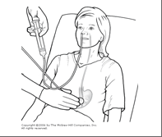
Checking NG Tube Placement

Slide 69
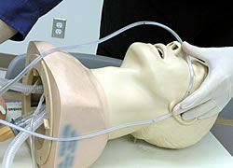
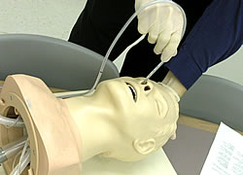
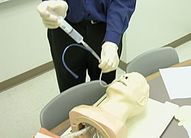
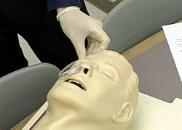
NG Tube Insertion (MITS)
Measure
Insert
Test
Secure

Slide 70
Practice inserting an NG tube
Measure:
Ear lobe to tip of nose to xiphoid process
Place a piece of tape on NG tube to mark depth
Position patient
Head neutral or flexed slightly forward for entrance into esophagus
Lubricate & insert (ask patient to swallow)
Verify placement
Use large syringe to inject air
listen for bubbling over stomach
Tape in place
DO NOT TAPE TO ET TUBE

Slide 71
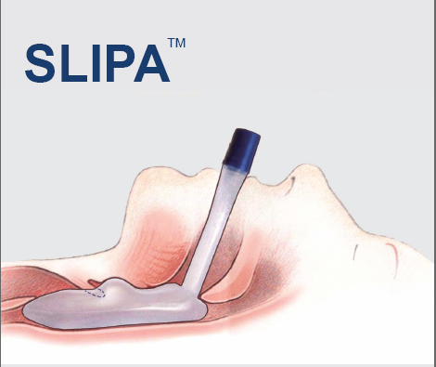

Slide 72
SLIPA - Streamlined Liner of the Pharynx Airway

Slide 73
SLIPA
Single-use supralaryngeal airway
Used for positive pressure ventilation (up to 30 cmH2O)
For use in anesthesia & emergency airway management
Cuffless
Seals at the base of the tongue
Hollow device can capture 50 mL of regurgitated fluid

Slide 76
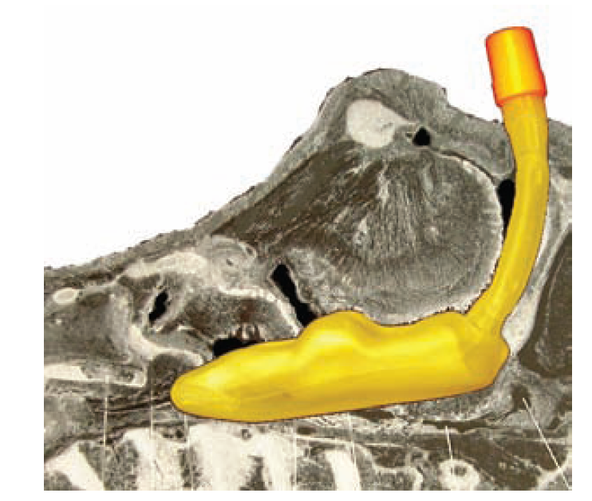

Slide 77
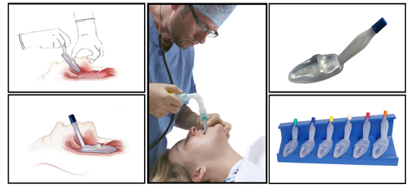

Slide 78
Pharyngotracheal Lumen Airway (PTL) (Double-lumen)
Rarely used – replaced by combitube.
See display board for sample

Slide 79
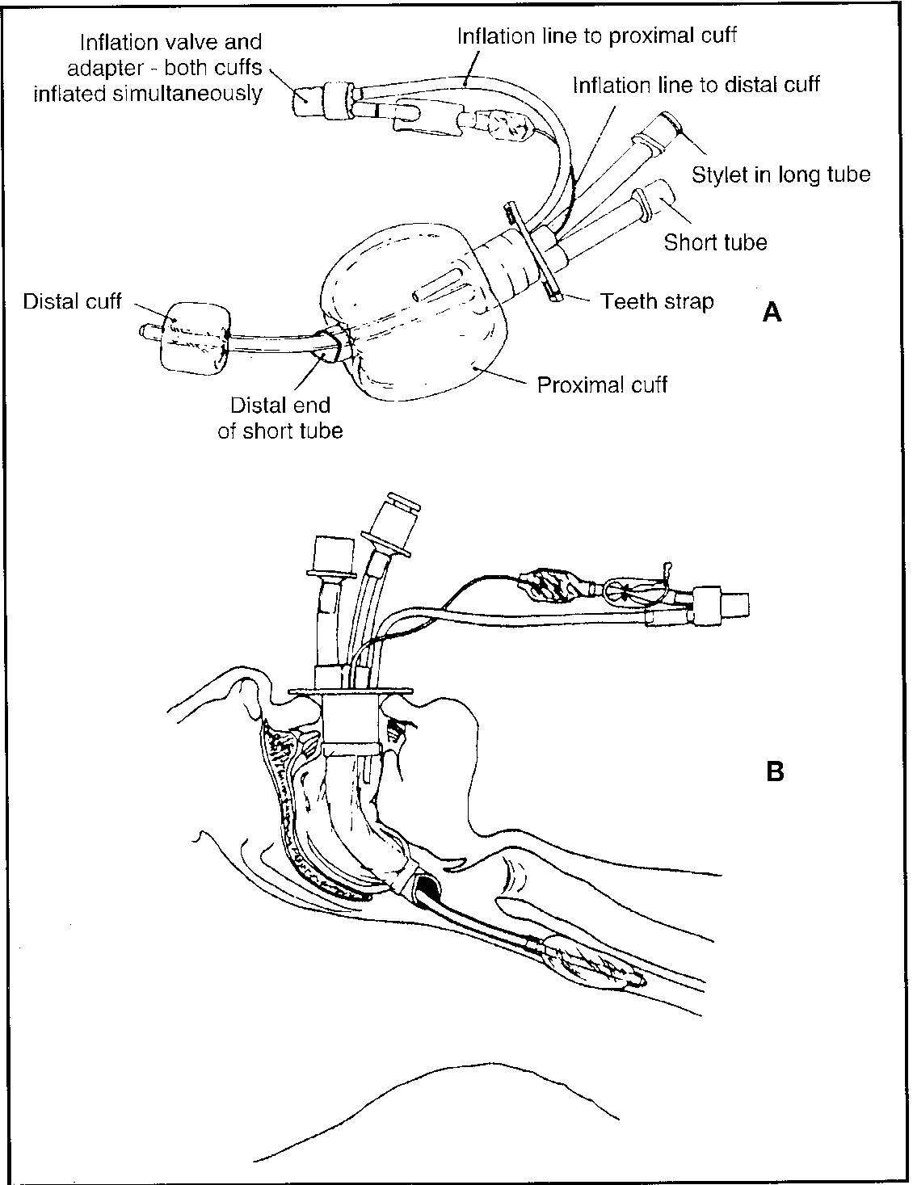

Slide 80
