Slide 1
RSPT 2335
MODULE A
AIRWAY MANAGEMENT
Part 4
Advanced Airways

Slide 2
Parts of Module A AIRWAY MANAGEMENT
Part 1 – Pharyngeal, Laryngeal & Esophageal Airways
Part 2 – Tracheal Airways
Part 3 – Airway Clearance
Part 4 - Advanced Airways
Part 5 - Airway Complications & Emergencies

Slide 3
OBJECTIVES
At the end of this module, the student should be able to…
describe the different types of endobronchial tubes (EBT).
explain when an EBT may be indicated.
given a patient scenario, determine the proper size EBT.
explain how to determine that the EBT is positioned properly.

Slide 4
OBJECTIVES
At the end of this module, the student should be able to…
explain patient transport options with a EBT.
describe the different unilateral lung procedures that might be necessary
explain the considerations when ventilating a patient with independent lung ventilation.

Slide 5
Major Topics
Unilateral Procedures
Endobronchial Tubes
Independent Lung Ventilation

Slide 6
Unilateral Procedures

Slide 7
Unilateral Procedures
Bronchoscopy
BAL-Cath sampling
CPT
Side-lying
Left lung suctioning (coude)
Endobronchial intubation
Independent lung ventilation

Slide 8
Side-lying
Patients normally in upright position
Maximized lung volumes and capacities
Decreased VAP risk
Side-lying position with unilateral disease or disorder
Good lung down
Increases blood flow to better lung and improves V/Q matching
Increase in oxygenation and PaO₂
Minimal effect on ventilation and PaCO₂

Slide 9
Left lung suctioning (coude)
What enhances entry into the left lung?
Coude catheter (L Bronchotrac)
Supine positioning
Left side lying
Head turned to left side
Tracheostomy tube in place vs. ET tube

Slide 10
Endobronchial Tubes

Slide 11
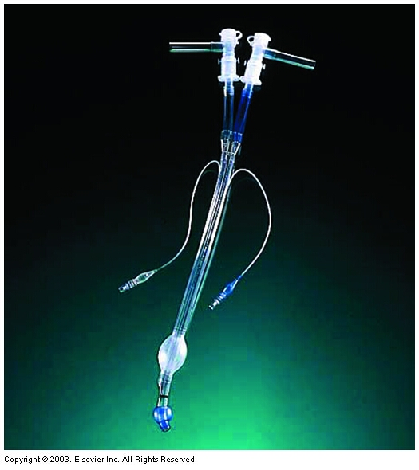
Endobronchial Tubes
Double lumen endobronchial tube (EBT) for independent lung ventilation

Slide 12
Endobronchial Tubes
About the tube
Indications
Considerations & Precautions

Slide 13
Endobronchial Tubes
About the tube – types:
Carlens - Has tracheal hook and is used for entry into left mainstem
White - Has tracheal hook and is used for entry into right mainstem
Robertshaw or Mallinckrodt - Designed to enter a mainstem bronchus but does not have a carinal hook

Slide 14
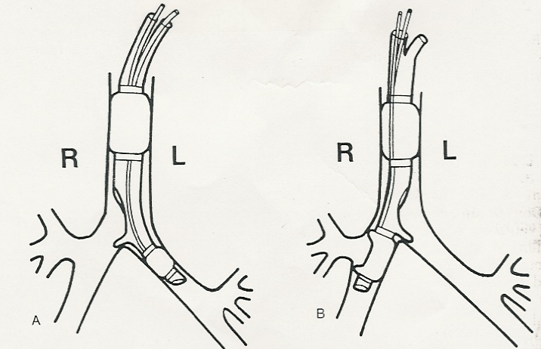
Carlens
White
Endobronchial tube with carinal hook

Slide 15
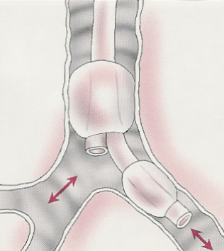
Robertshaw or Mallinckrodt
(no hook)

Slide 16
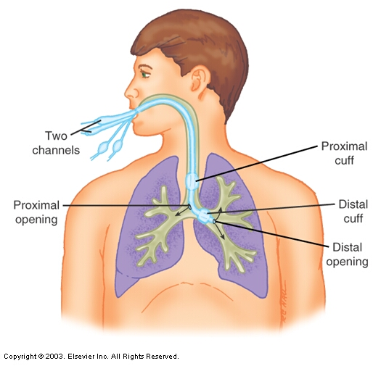
Correct positioning of double lumen endobronchial tube.

Slide 17
WEBSITES
Placement of endobronchial tube by direct laryngoscopy and fiberoptic bronchoscopy (10:57)
www.youtube.com/watch?v=p5NMhVwxlrY

Slide 18
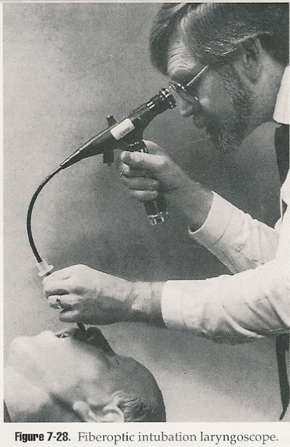
About the tube - Placement:
Often done using bronchoscope or intubation laryngoscope and bronchoscope

Slide 19
Endobronchial Tubes
Indications
Thoracic surgery - pneumonectomy, lobectomy, esophageal resection, aortic aneurysm, cardiac
Independent lung ventilation
in presence of unilateral lung problems
if needed to protect one lung from other
Disease or blunt trauma
Bronchopleural fistula
Bronchospirometry

Slide 20
Endobronchial Tubes
Considerations & Precautions
Sizing
Positioning
Transport

Slide 21
Endobronchial Tubes
Considerations & Precautions - Sizing:
Size: 39 French most common for adults
Depth: Obtain patient height in cm to determine depth
1. Height of 179 cm = 29 cm tube
2. Then add or subtract 1 cm to or from tube length for each 10 cm height difference

Slide 22
Endobronchial Tubes
Use of bilumen tube in pediatrics
Children >8 years
Bronchoport Rusch®
Neonate and children < 2-3 years
Marraro Paediatric Endobronchial Bilumen Tube, SIMS - Portex®

Slide 23
Endobronchial Tubes
Considerations & Precautions – Positioning of tube:
Insert/verify with bronchoscope
Auscultate
Chest wall movement
Chest x-ray
Monitor volume return on ventilator
Example: If inspired volumes do not match expired volumes, complete separation has not been accomplished (check position & cuff pressure)
Secure properly
Maintain cuff volumes & pressures

Slide 24
Endobronchial Tubes
Considerations & Precautions - Transport
One therapist with one wye adapter and one resuscitation bag
OR
Two therapists each with a resuscitation bag

Slide 25
Transport Do lungs need separate ventilation or can they be combined?

Slide 26
Endobronchial Tubes
Complications
inexperience in intubation
exclusion of the upper lobe bronchus in right bronchial intubation
dislodgment or obstruction of the tube
Herniation of the cuff with dislodgement or airway obstruction
trauma of the trachea and bronchi
difficult bronchosuctioning

Slide 27
Independent Lung Ventilation

Slide 28
Independent Lung Ventilation
Considerations & Precautions – Independent Lung Ventilation
Synchronous – vents connected by cable
Lead ventilator controls rate on both
All other settings can vary
Asynchronous
All settings can vary
If asynchronous (watch EtCO2)
May increase deadspace ventilation
May shift mediastinum
May decrease venous return and cardiac filling/output

Slide 29
Independent Lung Ventilation
Indications
Lung pathology with unilateral prevalence
Bilateral lung pathology complicated by monolateral atelectasis, pneumothorax or fistulae
Bilateral lung pathology with the patient in obliged to lay on one side
One lung ventilation during cardiothoracic surgery
Re-ventilation of the collapsed lung after cardiothoracic surgery. Post-operative phase of cardiothoracic surgery.

Slide 30
Independent Lung Ventilation
Advantages
Increase of functional residual capacity and effective ventilation in the more damaged lung
Reduction of hyperventilation and barotrauma in the less damaged lung
Use of selective PEEP in the two lungs
Isolation of secretions of the infected pulmonary areas hence less risk of diffusion of the infection from one lung to the other.
One lung ventilation during cardiothoracic surgery
Reventilation of the collapsed lung after cardiothoracic surgery

Slide 31
Independent Lung Ventilation
Considerations & Precautions – Ventilator settings during synchronized ventilation
Variable between lungs:
FiO₂
PEEP
Mode
Flows
Volumes (50% each)
Same for both lungs:
Rate

Slide 32
Independent Lung Ventilation
Considerations & Precautions –
Independent Lung Procedures:
You must decide which lung & how much
Aerosol therapy (Bronchodilators, antibiotics, surfactant, mucolytics…)
Humidification (fluids and heated water bath)
Suctioning (extra long & smaller 4-6 Fr and separate)
Graphics
Mechanics (Cs & Raw)
EtCO₂ Monitoring (monitor Vd)
Documentation (one form with right and left documented)

Slide 33
Independent Lung Ventilation
REMOVAL:
Improvement of chest x-ray
Reduction of FiO₂ < 0.40
Improvement of compliance

