Slide 1
RSPT 2335
MODULE A
AIRWAY MANAGEMENT
Part 3
Airway Clearance

Slide 2
Parts of Module A AIRWAY MANAGEMENT
Part 1 – Pharyngeal, Laryngeal & Esophageal Airways
Part 2 – Tracheal Airways
Part 3 – Airway Clearance
Part 4 - Advanced Airways
Part 5 - Airway Complications & Emergencies

Slide 3
Clinical Practice Guidelines
Endotracheal Suctioning of the Mechanically Ventilated Patients with Artificial Airways (2010)
Bronchoscopy Assisting (2007)
Humidification During Invasive and Non-invasive Mechanical Ventilation (2012)
Nasotracheal Suctioning (2004)

Slide 4
Assignments
Lab Chapter 36 – Bronchoscopy Assisting
36.1 – Identification of Components
36.2 – Preparation of Patient
36.3 – Preparation of Bronchoscope
36,4 – Bronchoscopy Procedure
36.5 – Bronchoscopy Recovery
36.6 - Bronchoscopy Complications

Slide 5
OBJECTIVES
At the end of this module, the student should be able to…
Describe each of the following as it relates to Bronchoscopy according to the AARC’s Clinical Practice Guideline: Fiberoptic Bronchoscopy.
Process
Goals
Indications
Contraindications
Hazards
Complications
Describe Transtracheal aspiration and explain its purpose.

Slide 6
Major Topics
Bronchoscopy
Bal-CATH
Rescue Cath
Transtracheal Specimen Collection
The “No Bite V” Suctioning Assist Device

Slide 7
Bronchoscopy

Slide 8
Bronchoscope Types
Rigid
Flexible fiberoptic

Slide 9
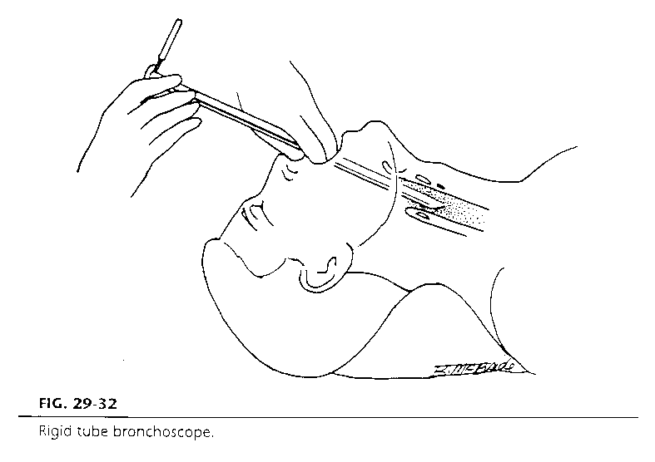
Rigid Scope mainly used in O.R.

Slide 10
Bronchoscopy - Fiberoptic
A diagnostic and/or therapeutic procedure
A bronchoscope (approximately 3 feet long) is inserted (usually by a physician) into the upper airway and allows direct visualization of the trachea and bronchi.
RCPs often assist the physician with this procedure.

Slide 11
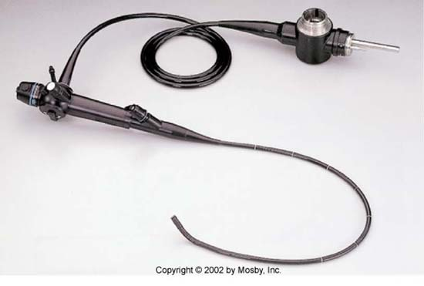
Fiberoptic Bronchoscope

Slide 12
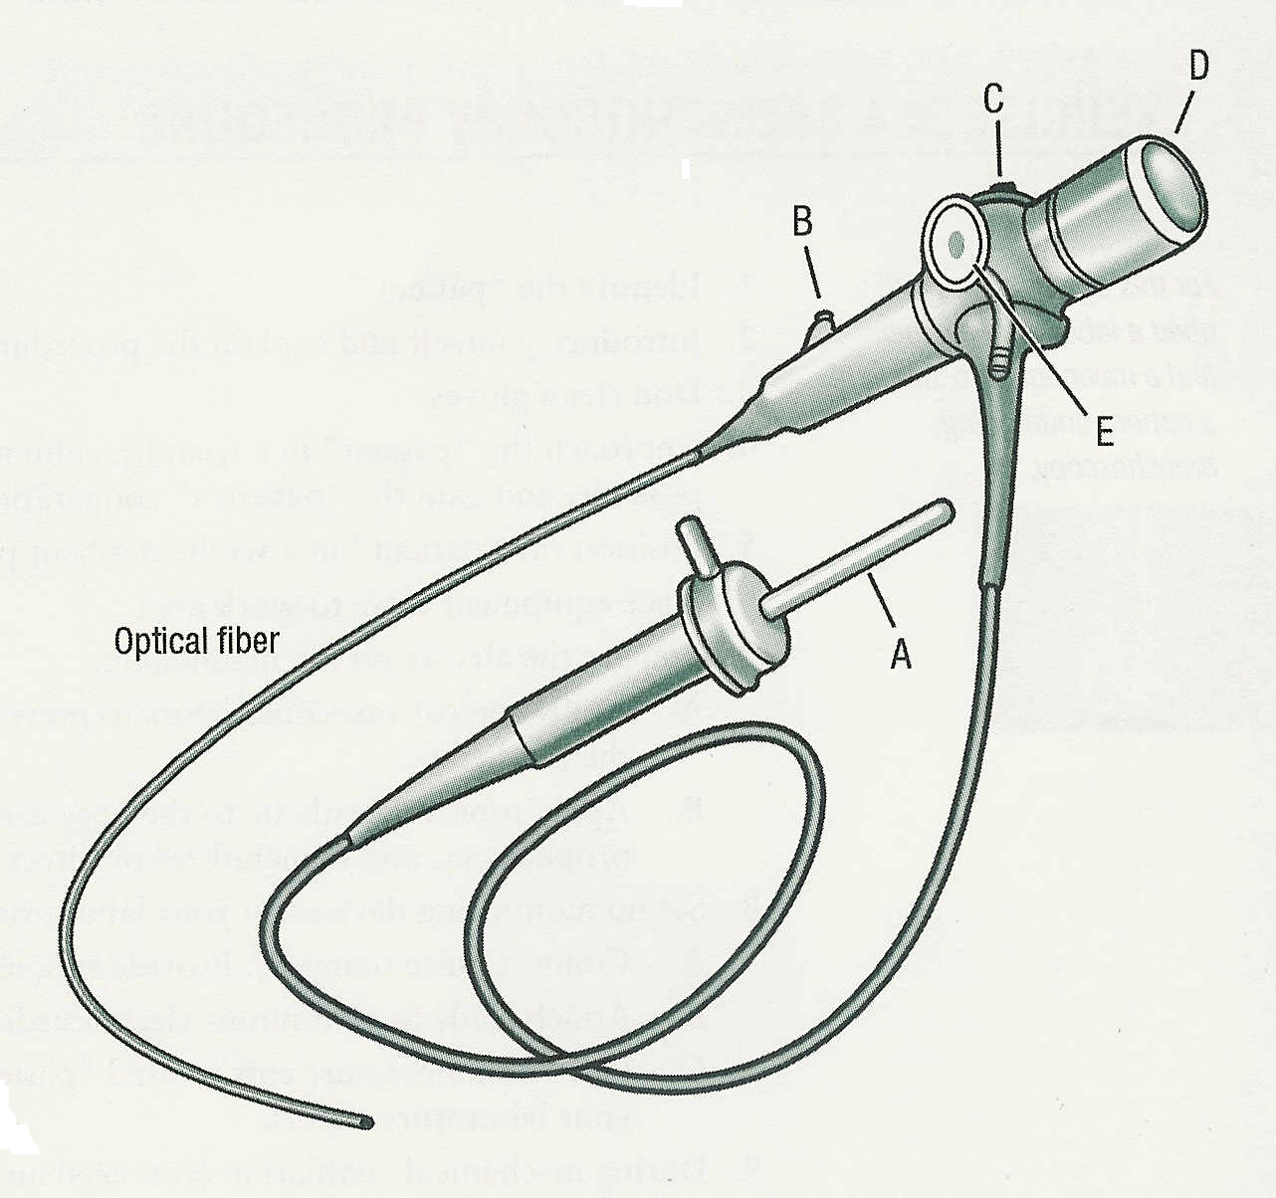

Slide 13
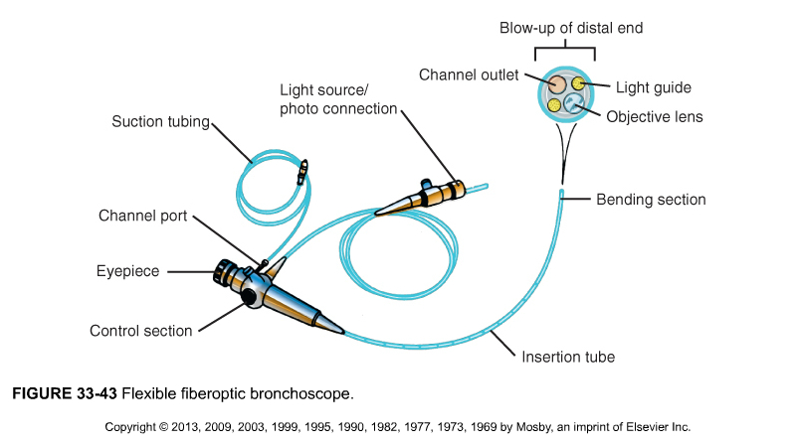
Instillation & tool port

Slide 14
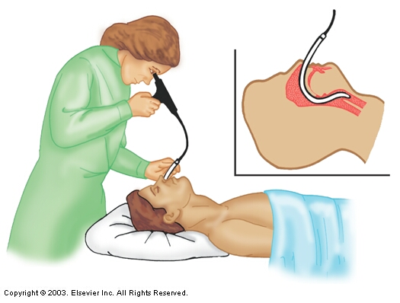
Additional tool for intubation
Fiberoptic Laryngoscopy

Slide 15
Bronchoscope Features
Fiberoptic light source for visualization
Suction channel for instilling liquids for cell/secretion removal or coagulation
Lumen for metal alligator forceps, small wire brush or needle to be passed down so tissue specimens can be obtained
Lumen allowing laser for removal of abnormal tissue

Slide 16
Purposes for Bronchoscopy
DIAGNOSTIC
(looking for…)
THERAPEUTIC
(treatment of…)
Suspect foreign body
Foreign-body obstruction
Suspect malignancy
Lazar removal of tissue
Pulmonary infections
Removal of secretions from bronchial area (not tracheal)
Hemoptysis
Instillation of meds
Pressure application
Solution to persistent problems
Relief of atelectasis (plug)
Dilation of a stenosis

Slide 17
Responsibilities of the RT During Bronchoscopy
Check the chart – order, lab data, x-ray reports…
Prepare the patient
Interview (NPO x 8 hours, drug allergies, sedation tolerance…)
Assess (vital signs, P Ox, breath sounds…)
Instruct (what to expect)
Position (semi recumbent)
Obtain vascular access

Slide 18
Responsibilities of the RT During Bronchoscopy
Prepare and check Bronchoscope
Light
Thumb control
Eyepiece focus
Patency of suction & biopsy channel
Set-up supplies

Slide 19
Bronchoscopic Equipment
Bronchoscope(s)
video/photographic equipment
cytology brushes, forceps, needles, retrieval baskets
water soluble lubricant
sterile gauze
Specimen collection supplies
PPE
vacuum equipment
containers
fixatives
syringes
lavage solutions (saline, mucomyst, epinephrine)
Ventilation supplies
ventilator adapter
bite block
Venous access equipment
Medications [atropine, anesthetic, opioid analgesic, benzodiazepines, narcan, topical anesthesia (aerosol & instilled)]
Monitoring devices
ECG, pulse ox, BP, capnograph
Treatment equipment
Oxygen & equipment
Resuscitation equipment
Intubation equipment
laryngoscope
endotracheal tubes
LMA
Paperwork
Radiology badge (for fluoroscopy)

Slide 20
Responsibilities of the RT During Bronchoscopy
Prepare the airway
Pseudoephedrine nasal spray (prevent bleeding)
Topical anesthetic (Lidocaine)
by atomizer to nose
by mouthwash to oral pharynx
by nebulizer or instilled in bronchoscope to lungs

Slide 21
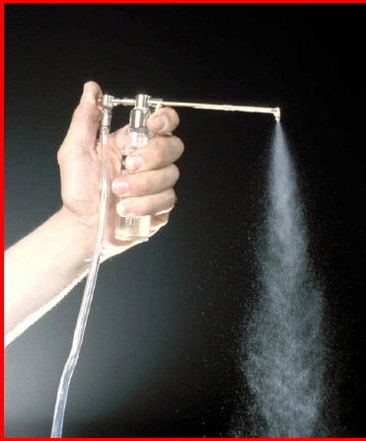
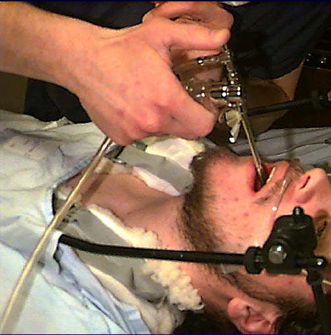
Anesthetize the airway

Slide 22
Responsibilities of the RT During Bronchoscopy
Administer other medications
(per institution policy)
Oxygen
Conscious sedation (opioids & benzodiazapines)
Anticholinergic (atropine or glycopyrrolate)
Mucomyst (10 – 20%)
Vaponephrine or Epinephrine (1:10,000)
Albuterol
Assist with the procedure

Slide 23
Responsibilities of the RT During Bronchoscopy
Monitor the patient
Pulse oximeter
ECG monitor
BP monitor
Adjust ventilator & O2 as needed
Use bite block or ventilator adapter as needed

Slide 24
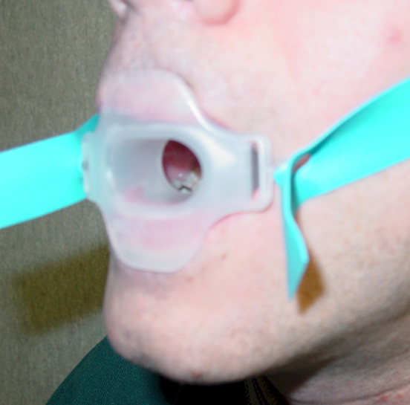
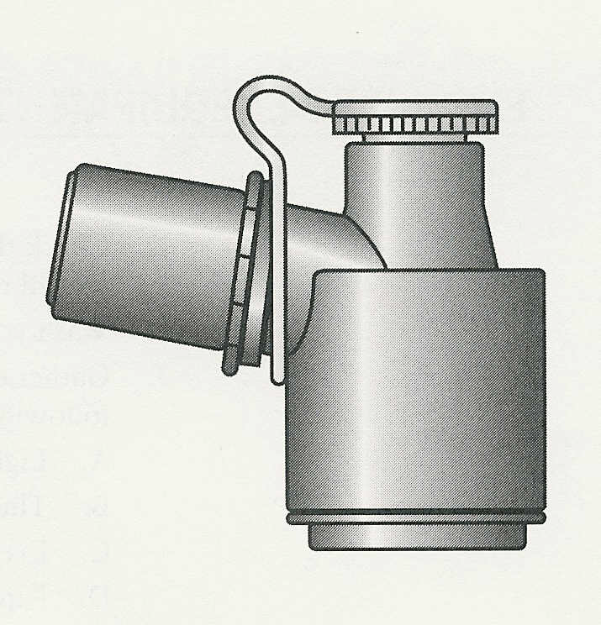
Ventilator Adapter
(Bodai)
Non-intubated patient needs “Bite Block”

Slide 25
Responsibilities of the RT During Bronchoscopy
Perform post-procedure care of the patient
Monitor oxygenation & ventilation
Monitor breath sounds for wheezing or loss of sounds (pneumothorax)
Keep NPO until anesthetic wears off
Monitor for airway complications (stridor or laryngospasm)
Monitor for hemoptysis

Slide 26
Responsibilities of the RT During Bronchoscopy
Process the specimens
Clean equipment after use (Gluteraldehyde)
Restock bronchoscopy cart
Documentation & billing

Slide 27
Critical Thinking Question
Would you recommend a rigid or flexible bronchoscopy for Ms. Swanson, a 43-year-old Hispanic woman with a history of hemoptysis. A chest radiograph revealed a mass in her right middle lobe. She is scheduled for a bronchoscopy and possible biopsy.

Slide 28
Critical Thinking Question
While a bronchoscopy is being performed on a mechanically ventilated patient, you notice the high-pressure alarm is sounding. What are the possible causes and corrective actions?

Slide 29
Critical Thinking Question
If the physician informs you that the light on the bronchoscope is no longer visible, what would you suggest to correct the problem?

Slide 30
Critical Thinking Question
A pulmonary fellow is performing her first bronchoscopy and informs you that the entire airway is blurry and suggests instillation of saline to clear the scope. You proceed with the instillation of saline and suction but the field fails to clear. What would you suggest in order to clear the field?

Slide 31
Critical Thinking Question
A patient with documented hypertension has been schedule for a flexible bronchoscopy. Which of the commonly administered medications during bronchoscopy might cause an adverse reaction? Explain your answer in detail.

Slide 32
Critical Thinking Question
While assisting with a bronchoscopic procedure for a patient on a mechanical ventilator, you notice that the PEEP has been steadily increasing as the physician inserts the bronchoscope through the endotracheal tube into the airways. What may be the cause of this and what should be done?

Slide 33
Critical Thinking Question
Mr. Levy is in the recovery room following a bronchoscopy. He is seated upright in bed with a 2 L/min nasal cannula in place. His vital signs are stable but oxygen saturations are beginning to fall below 88%. The patient begins complaining of difficulty breathing. Upon auscultation, you can hear wheezing throughout the upper airways on inspiration and exhalation. What would you suggest be done for this patient?

Slide 34
Critical Thinking Question
A patient is undergoing a bronchoscopy for removal of thick, inspissated secretions. While assisting with the procedure and monitoring the patient, you note that the patient’s oxygen saturation has fallen from 95% to 84%. Though you have increased the oxygen delivery from 3 L/min nasal cannula to 6 L/min nasal cannula, the oxygen saturation has not changed. What would you suggest be done for this patient?

Slide 35
Bal-CATH

Slide 36
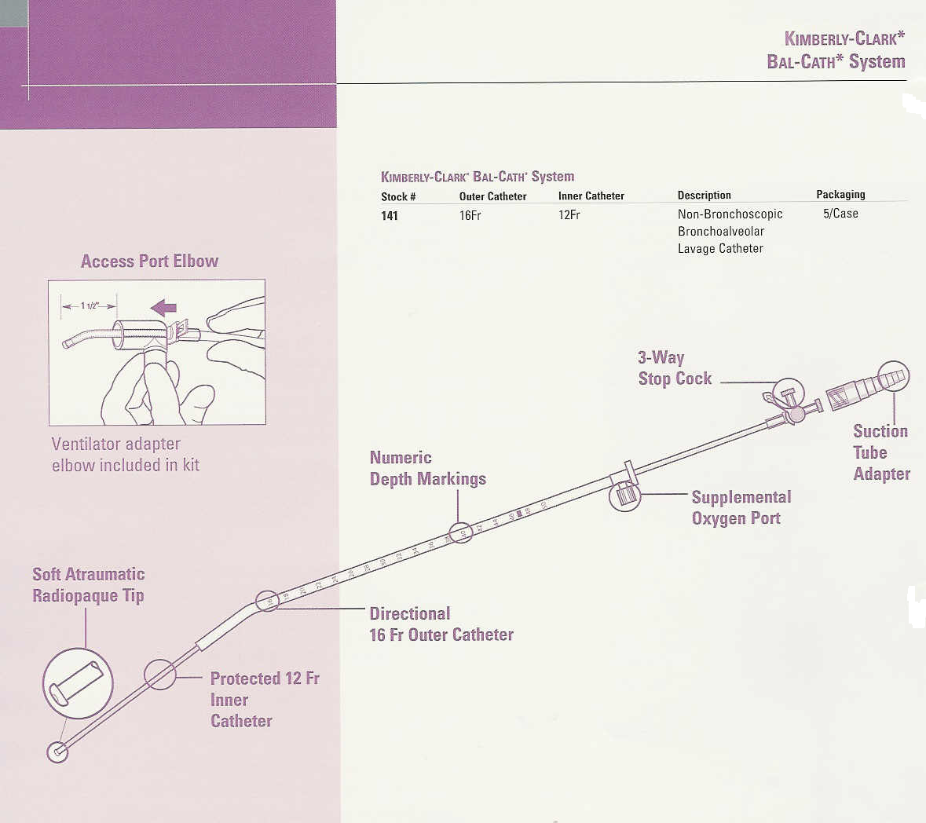

Slide 37
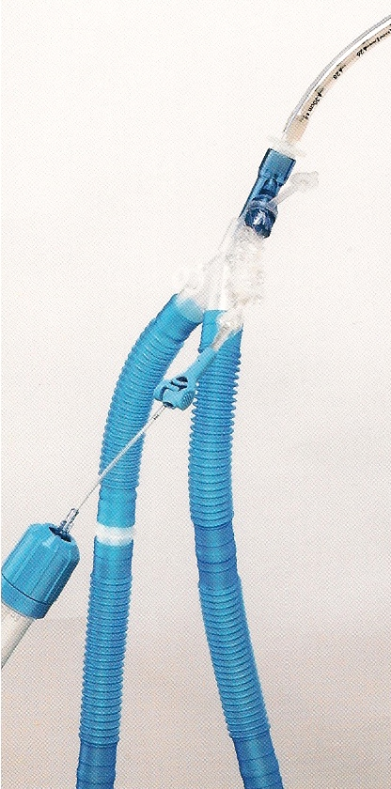
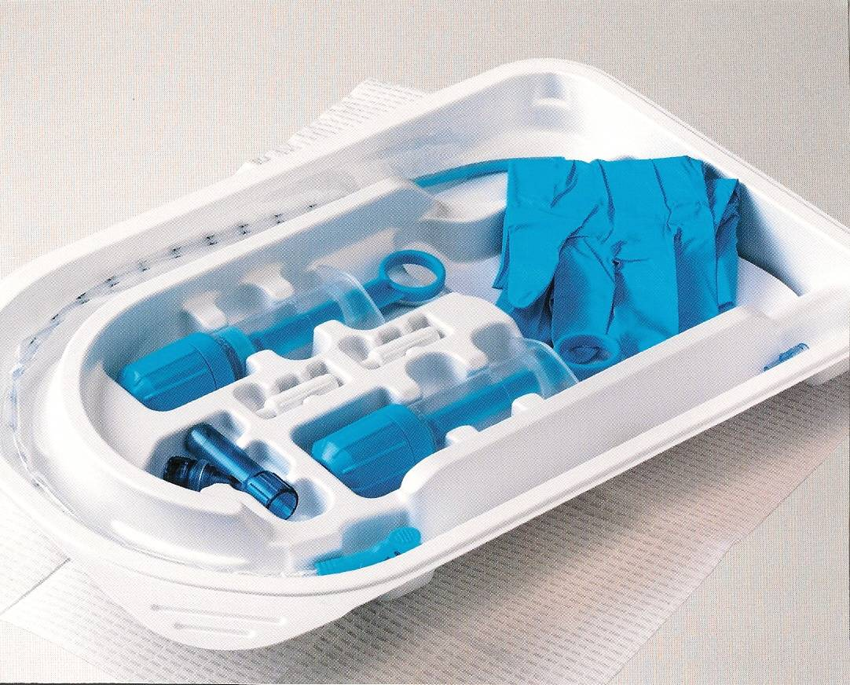
Mini-BAL

Slide 38
Bal-CATH
Bal-CATH is a telescoping catheter with a directional tip that is positioned in the distal airway to obtain an alveolar lavage sample
Used to obtain a lower respiratory tract sputum specimen and improves diagnostic yields over tracheal aspirated or expectorated sputum samples
Has been shown to have similar accuracy to bronchoscopy in obtaining alveolar specimens
It is a disposable, single patient use item.

Slide 39
Bal-CATH
Purpose:
Facilitates the diagnosis of diffuse lung disease including pneumonia (used for H1N1)
Helps identify the organism for more targeted treatment
Gets a deep lung sample without a bronchoscopy
May be done by the specially trained RT

Slide 40
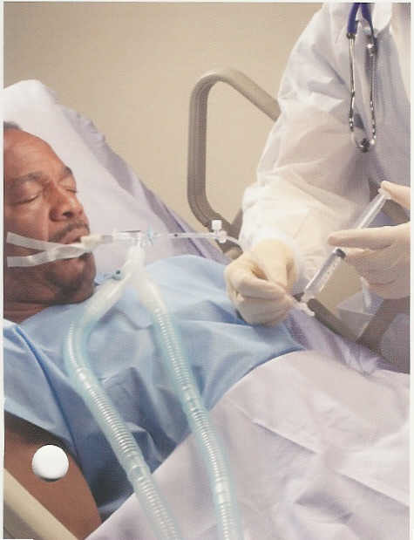
Process:
A catheter in a sheath is inserted into the lungs to the desired depth
The catheter alone is then advanced, instillation & suction are performed and the specimen obtained
The catheter is returned to the sheath then removed.

Slide 41
Advantages over Bronchoscopy
Can be performed by an RT or RN
Smaller catheter
Shorter procedure (1 – 8 minutes)
Smaller lavage volumes (20 – 40mL) & quicker post procedure stabilization & recovery times
Results similar to bronchoscopy
Directionality is not nearly as important as simply getting a quantitative culture (not contaminated by subglottic secretions

Slide 42
Care Fusion Video Mini-BAL Mini Bal Demo (7:59 min) DVD

Slide 43
Rescue Cath

Slide 44
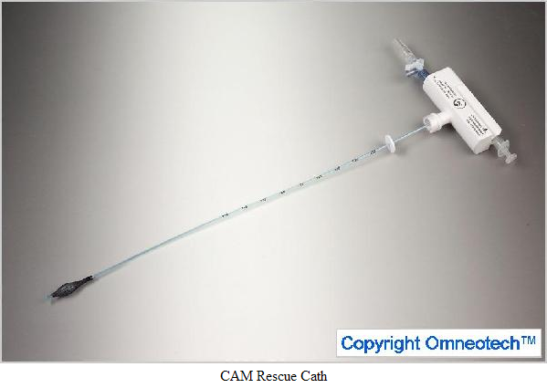
Rescue Cath

Slide 45
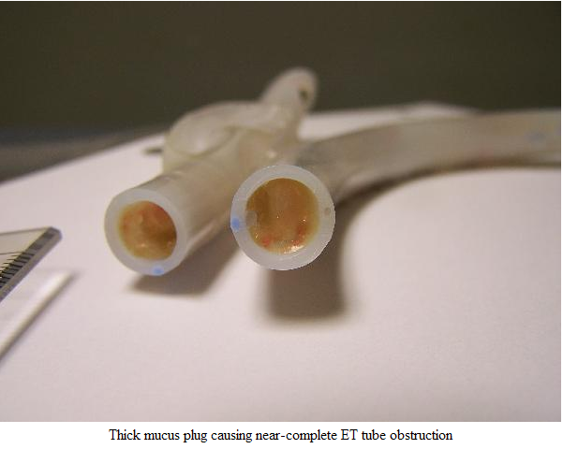
Rescue Cath

Slide 46
Rescue Cath

Slide 47
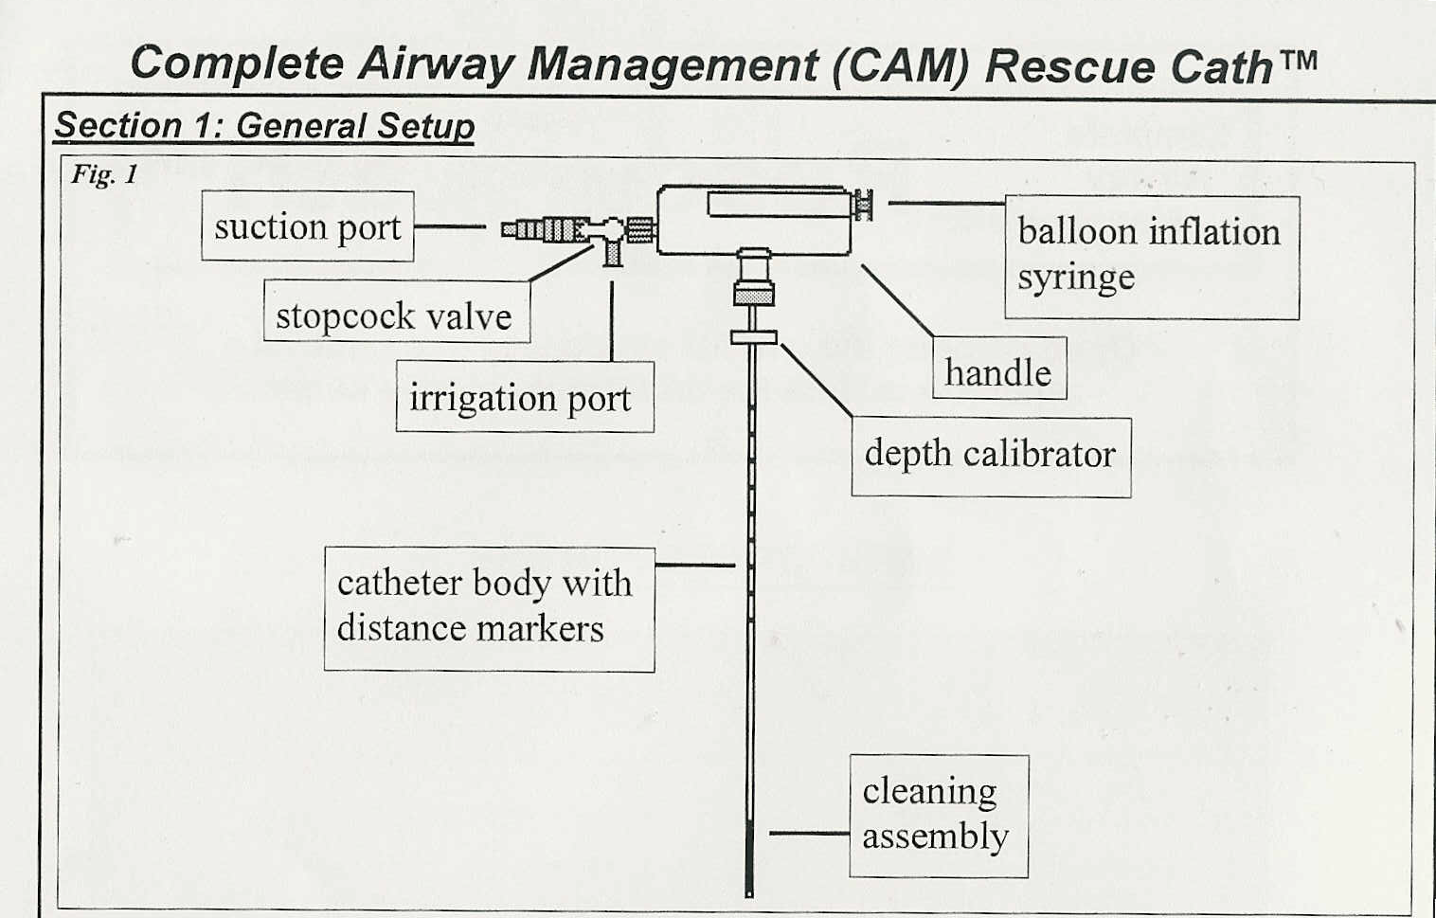

Slide 48
CAM Rescue Cath
Single use open catheter system for suctioning and removing secretions from endotracheal tube lumen
Catheter must be calibrated to the length and width of the endotracheal tube to avoid airway injury.
8 Fr. Rescue-cath for 6.5 – 9.5 mm ID ET
Align markers on Rescue-cath with ET markers
Be sure to securely hold the endotracheal tube while using the Rescue-cath to prevent dislodgement.

Slide 49
CAM Rescue Cath
Each “pass” of the Rescue-cath should last 10 seconds or less
When using the Rescue –cath during ET “cleaning”:
Inflate balloon with up to 3 mL of air
Be sure balloon is in endotracheal tube
do not apply suction
When using the Rescue –cath during ET “suctioning” – keep the balloon deflated

Slide 50
Transtracheal Sampling

Slide 51
Transtracheal Sampling
This is a rare physician-performed maneuver:
A catheter can be inserted through the cricothyroid membrane into the trachea for the purpose of aspirating secretions.
Uncontaminated specimens can be useful in diagnosing Legionnaire’s Disease.
Typically a 21-gauge plastic catheter/needle assembly is used.
Once in place, vacuum system is attached.

Slide 52
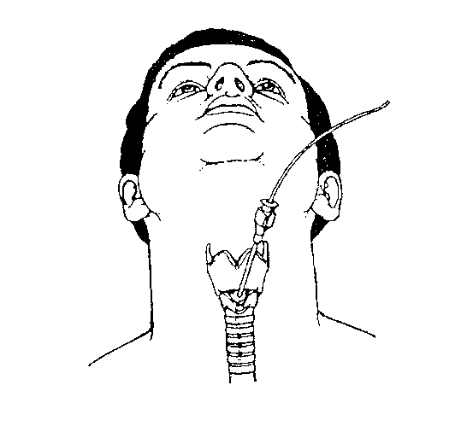

Slide 53
The No Bite V

Slide 54
The “No Bite V” Suctioning Assist Device
See No Bite V Inservice:
http://www.njrmedical.com/ (5:40)

Slide 55
The “No Bite V” Suctioning Assist Device
Prevents patient biting down during:
Oral cleaning
Oral and tracheal (above the cuff) suctioning
NG insertion
Illuminates the inside of the mouth for oral assessment
Allows for oral tracheal suctioning vs. nasotracheal suctioning

Slide 56
The “No Bite V” Suctioning Assist Device
Contraindications – Epiglottitis, croup, pediatrics, acute head, facial or neck injury, coagulopathies, laryngospasm, bronchospasm, MI, URTI, tracheal surgery, high gastric surgery
Potential complications –trauma, hemorrhage, tracheitis, edema, hypoxia, dysrhythmias, vital sign change, coughing, gagging, vomiting, laryngospasm, discomfort, pain, nosocomial infection, atelectasis, increased ICP, IVH, pneumothorax

Slide 57
The “No Bite V” Suctioning Assist Device
Precautions:
Obtain physician order before use
Do not use on pediatric patients
Do not use on patients with moderate to severe oral disease
Do not use on patients with recent trauma or surgery to upper airway, larynx or trachea
Do not twist or try to remove if patient is biting
Do not use like crow-bar on teeth
Do not place fingers in mouth or beyond suction insertion hole

