Slide 1
RSPT 2335
Mechanical Ventilation
Module C

Slide 2
MODULE C - MANAGEMENT LESSONS
Management of the ventilated patient with COPD
Management of the ventilated patient with ASTHMA
Management of the ventilated patient with ARDS
Management of the ventilated patient with OTHER CONDITIONS

Slide 3
RSPT 2335
Mechanical Ventilation
Module C
MANAGEMENT LESSON #1
COPD

Slide 4
MODULE C - Assignments
READ: (See First Day Handout)
  Clinical Man & Assess of Resp Dis (7th ed.)
    Chapter 12 – Chronic Obstructive Pulmonary Disease ,
    Chronic Bronchitis, and Emphysema
  Pilbeam (5th ed.) - Mechanical Ventilation
Computer simulation
Lab on Dual Ventilator Modes
  PRVC, VC+, Autoflow
  Volume Support

Slide 5
MODULE C - Assignments
Optional videotape (E-108):
  Professor’s Rounds 2011 – Management of the Patient with COPD
  Professor's Rounds 2008 – Efficacy of New Modes of Mechanical Ventilation
  Many others under TV in E-108

Slide 6
MODULE C -Objectives
When you complete this module, you should be able to…
  describe the problems associated with emphysema
  describe the non-invasive methods for caring for COPD patients
  describe the invasive methods for caring for COPD patients
  discuss the different methods for improving CO2 removal

Slide 7
MODULE C -Objectives
When you complete this module, you should be able to…
  explain which patients may need their CO2 in the normal range
  explain which patients may need hyperventilation techniques
  explain which patients may need permissive hypercapnia techniques

Slide 8
MODULE C - Objectives
When you complete this module, you should be able to…
  Compare and contrast volume vs. pressure control ventilation.
  Describe the most common pressure modes of ventilation.
  Compare the advantages and disadvantages of the most common modes of ventilation.
  Describe the type of patients suitable for the most common modes.

Slide 9
MODULE C - Objectives
When you complete this module, you should be able to…
  Draw graphics for each mode.
  List the initial settings for the most common modes.
  Describe the most common dual modes of ventilation.
  List the less common dual modes of ventilation.

Slide 10
MODULE C
Major Topics
COPD Summary
Non-invasive Strategies
Invasive Strategies
Dual Modes Ventilation
Scenario & Case Studies

Slide 11
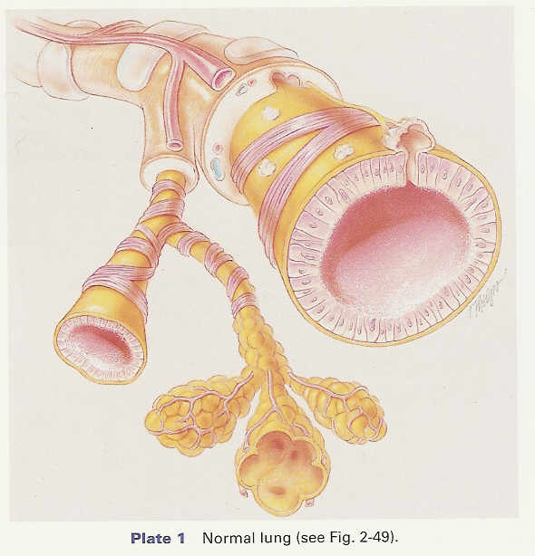
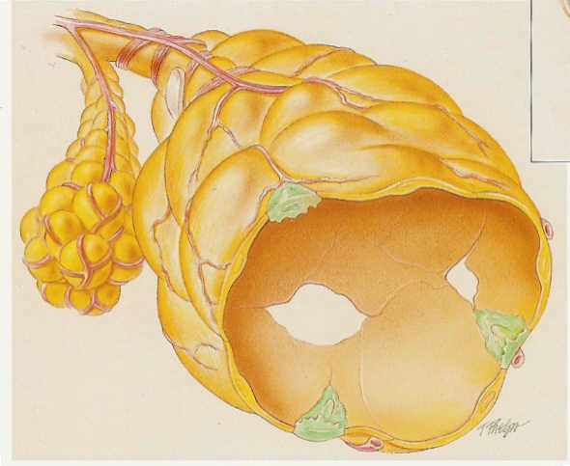
What we already know…
Emphysema
COPD SUMMARY

Slide 12
C.O.P.D. - ANATOMIC CHANGES
Enlargement of distal air spaces (remodeling)
Distal airway collapse (loss of elastance)
Alveolar gas trapping
Bronchospasm
Loss of pulmonary capillary bed (diffusion effect)
Decrease surface area for gas exchange
Ventilation in excess of perfusion (deadspace)

Slide 13
C.O.P.D. - SIGNS & SYMPTOMS
Dyspnea on exertion
Abnormal PFT
  Decreased FVC, FEV1 & flows
  Increased RV, FRC & RV/TLC ratio
Cough & sputum production
Wheezing, crackles, rhonchi
AmLessory muscle use & tripod use
Pursed lip breathing
Barrel chest
  Decreased - breath & heart sounds, tactile & vocal fremitus
  Hyperresonant percussion

Slide 14
C.O.P.D. - SIGNS & SYMPTOMS
Abnormal ABG
  Chronic ventilatory failure
  Chronic hypoxemia
Abnormal x-ray *
  Flattened diaphragms
  Hyperlucent lung fields
  Long narrow heart
  Flattened ribs
  Increased retrosternal air space

Slide 15
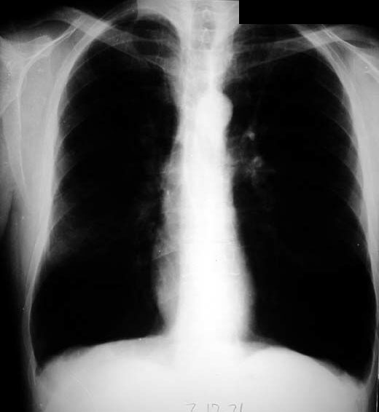
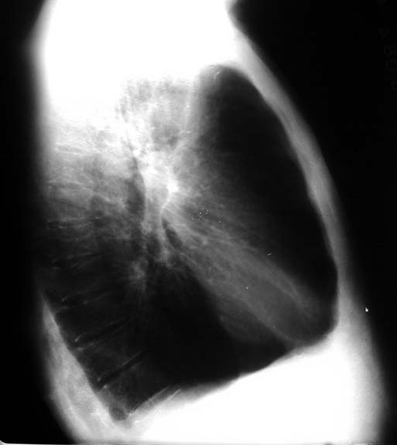

Slide 16
C.O.P.D. - SIGNS & SYMPTOMS
Chronic hypoxemia
  Cyanosis
  Increased PAP, PVR, CVP
  Digital clubbing
  Polycythemia
Cor Pulmonale
  JVD
  Hepatomegaly
  Pedal edema

Slide 17
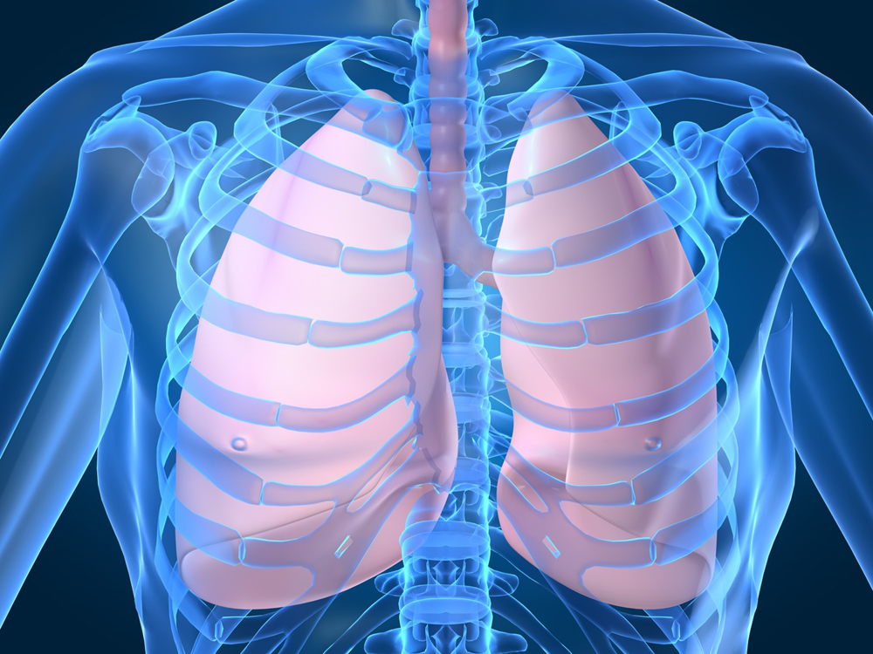
Goal of Therapy in COPD…
…Empty the lungs!

Slide 18
Let’s Do A Clinical Simulation
Use simulation tips provided by instructor
Look up things you do not know (PARKING LOT)
Repeat simulations on your own in CE-102

Slide 19
ICS-7 (Self-Evaluation Software)
Chris Williams – 67 year old Emphysema patient – Critical Care

Slide 20
MODULE C
Major Topics
COPD Summary
Non-invasive Strategies
Invasive Strategies
Dual Modes Ventilation
Scenario & Case Studies

Slide 21
Non-invasive Management Strategies
Long Term Oxygen Therapy (LTOT)
  Low flow (nasal cannula) & high flow (NC or AEM )
Patient positioning (head up, tri-pod)
Aerosol therapy
  Beta 2 agonists, anticholinergics, methylxanthines, inhaled steroids
Bronchial hygiene
  PEP Therapy, Acapella, flutter, vest…
VamLines & antibiotics (as needed)
Pulmonary Rehabilitation
  Exercise, education, nutrition, smoking cessation…
NIPPV

Slide 22
MODULE C
Major Topics
COPD Summary
Non-invasive Strategies
Invasive Strategies
Dual Modes Ventilation
Scenario & Case Studies

Slide 23
Invasive Management Strategies
Surgery & Implants
Decrease metabolism (CO₂ production)
C. Improve perfusion
D. Optimize ventilation

Slide 24
Invasive Management Strategies
Surgery
  Bullectomy
  Lung transplant
  Lung volume reduction surgery (LVRS)
  Airway stents & one-way-valves
  PneumRx Wires (new)

Slide 25
Bullectomy
A Bulla (plural bullae) is an air space in the lung measuring more than one centimeter in diameter in the distended state
http://www.youtube.com/watch?v=cj_uYH2sym4
  VATS (Video-Assisted Thoracoscopic Surgery)
  Removal of a bullae

Slide 26
Lung Transplantation
Candidates should be projected no more than 2-year survival.
Smoking cessation for at least 6 months prior to surgery.
Age limit
  65 years for single lung transplant.
  60 years for bilateral.
FEV₁ & DLCO less than 20% predicted.

Slide 27
Lung volume reduction surgery (LVRS)
Many people who suffer with emphysema have portions of the lung which are more affected than others.
This finding led to the development of a surgical approach to treat emphysema.
LVRS involves removing about 20 to 30 percent of the damaged lung so that the remaining tissue and surrounding muscles are able to work more efficiently, making breathing easier.
By reducing the lung size, the remaining lung and surrounding muscles (intercostals and diaphragm) are able to work more efficiently.
This makes breathing easier and helps patients achieve greater quality of life.
http://umm.edu/programs/thoracic/services/lvr

Slide 28
Airway stents & one-way-valves
A new class of minimally invasive interventions delivered through a bronchoscope is under development for improving respiratory function for patients with COPD.
Airway stents can be used to stabilize the patency of some airways while one-way valves or biocompatible glue can be used to close off other airways entirely.
Ideally, one would prefer to use stents to reducing air-trapping in lung regions that are otherwise functional, and to use one way valves and glue to close off lung regions that have lost their gas exchange capability.

Slide 29
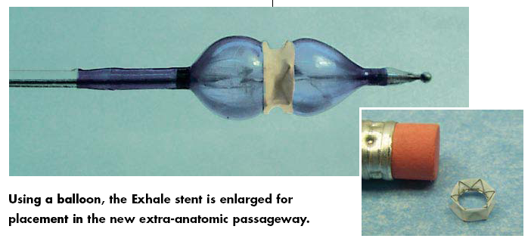
Airway stents

Slide 30
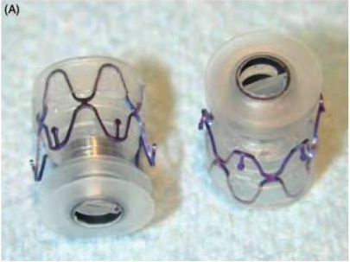
Endobronchial Valves

Slide 31
PneumRX
The RePneu Coils are made of Nitinol, a biocompatible, shape-memory alloy.
After being straightened for insertion into the lung, they gather up and compress the diseased lung tissue surrounding them as they return to their original shape.
The Coils improve lung function in three ways:
  Coils compress diseased tissue, which provides room for healthier tissue to function.
  Coils re-tension adjacent parenchyma, which enables the lung to more efficiently contract.
  Coils tether open small airways, which reduces air trapping and hyperinflation.

Slide 32
Invasive Management Strategies
Surgery
Decrease metabolism (CO₂ production)
C. Improve perfusion
D. Optimize ventilation

Slide 33
Circle of Ventilation
Metabolism: temperature, activity, nutrition, drugs, seizures…
Tissue
Decrease Production
Lungs
Improve Removal
Blood
Improve Carrying
Increase rate,
Eliminate auto-PEEP,
Spontaneous breathing,
Therapeutics,
Increase tidal volume,
High frequency vent.
Dissolved + HB
Buffering
Heart
Improve Pumping
Poor perfusion leads to CO2 retention at tissues

Slide 34
Optimize Metabolism
Appropriate Nutrition
  Malnutrition can cause muscle fatigue, ventilatory insufficiency, ventilatory failure, muscle atrophy and failure to wean.
  Many COPD patients don’t eat right:
    Too tired or SOB to eat or prepare meals.
    Change in appetite due to meds.
    Change in sense of taste and smell due to oxygen therapy.
    Large meals push up diaphragm and cause SOB.

Slide 35
Optimize Metabolism
Appropriate Nutrition
  COPD patients can have tremendous increase in calorie needs (up to 3000/day) due to increased work of breathing.
  They need to eat/drink more than normal.
  They need to eat/drink the right things.

Slide 36
Optimize Metabolism
Decrease CO₂ production
  At Home control diet:
    Low carbohydrate diet (Pulmo-care).
    High protein & good fat diets are needed.
  When in hospital:
    Control fever.
    Stop shivering.
    Decrease activity (sedation).
    Evaluate use of stimulants (caffeine…).
    Treat seizures.

Slide 37
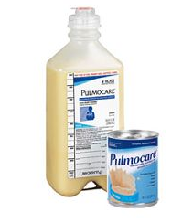
Pulmocare
A high-calorie, low-carbohydrate formula designed to help reduce carbon dioxide production, thereby minimizing CO2 retention resulting from chronic obstructive pulmonary disease, cystic fibrosis, or respiratory failure.
Pulmocare is appropriate for ambulatory or ventilator-dependent patients.

Slide 38
Circle of Ventilation
Metabolism: temp., activity, nutrition, drugs, seizures…
Tissue
Decrease Production
Lungs
Improve Removal
Blood
Improve Carrying
Increase rate,
Eliminate auto-PEEP,
Spontaneous breathing,
Therapeutics,
Increase tidal volume,
High frequency vent.
Dissolved + HB
Buffering
Heart
Improve Pumping
Poor perfusion leads to CO2 retention at tissues

Slide 39
Invasive Management Strategies:
Surgery
Decrease metabolism (CO₂ production)
C. Improve perfusion
D. Optimize ventilation

Slide 40
Improve Perfusion
Reduce Air-trapping!!!
  Dynamic hyperinflation and auto-PEEP may produce life threatening cardiac compromise
  Poor perfusion leads to CO₂ (acid) retention at the tissues
  CO₂ must be pumped back to the lungs for removal

Slide 41
Circle of Ventilation
Metabolism: temp., activity, nutrition, drugs, seizures…
Tissue
Decrease Production
Lungs
Improve Removal
Blood
Improve Carrying
Increase rate,
Eliminate auto-PEEP,
Spontaneous breathing,
Therapeutics,
Increase tidal volume,
High frequency vent.
Dissolved + HB
Buffering
Heart
Improve Pumping
Poor perfusion leads to CO2 retention at tissues

Slide 42
Invasive Management Strategies:
Surgery
Decrease metabolism (CO₂ production)
C. Improve perfusion
D. Optimize ventilation

Slide 43
Optimize Ventilation
  Provide therapeutics
  Change modes
  Adjust tidal volume
  Reduce physiologic deadspace by eliminating auto-PEEP
  Reduce mechanical deadspace
  Correct for circuit volume loss
  Adjust rate
  Maintain patient ventilator synchrony
  Allow for spontaneous breathing

Slide 44
Ventilation
Most critical life function!
If possible - fix this first!
PaCO₂ is the best measure of patient's ventilatory status
  For COPD patients the PaCO₂ is often >50 mmHg
  Avoid alkalosis - shoot for pH 7.30 – 7.35 range
  CAUTION: Hypoventilation may be the cause of hypoxemia and oxygen therapy is usually indicated to maintain PaO2 >/= 60 mmHg.

Slide 45
Where should the PaCO₂ level be?
PERMISSIVE HYPERCAPNEA
(High PaCO₂ with pH >7.25)
  ARDS
  Asthma
  Severe pneumonia
  Emphysema
  Severe metabolic alkalosis

Slide 46
Where should the PaCO₂ level be?
NORMOCAPNEA
(PaCO₂ 35 - 45 mmHg)
  Most ventilator patients
  Neuromuscular
  Post-op

Slide 47
Where should the PaCO₂ level be?
HYPERVENTILATION
(PaCO₂ 25 - 30 mmHg)
  Closed Head Injury during times of uncontrolled ICP increases.
  Metabolic acidosis
  Persistent Pulmonary Hypertension (PPH or PFC)

Slide 48
Apply Appropriate Therapeutics
Patient position (30 – 45 degree head up)
Consider bronchodilation (SABA), (LABA) & steroids
Bronchial hygiene (suctioning, PEP, CPT, IPV, Acapella…)
Consider humidification & hydration
Consider size & type of airway
Consider sedation level
Consider changing position of patient (good lung down)

Slide 49
Use Proper Mode
Assist control volume ventilation
  Unload muscles
  Watch for hyperinflation and high pressures
  Watch for dysynchrony
Assist control pressure ventilation
  Allows volume & flow variability
  Watch volumes closely
Dual Modes
  Within a breath: VAPS, PAug
  Breath to breath - time cycled: PRVC, Auto-flow, VC+, APV, VPC
  Breath to breath - flow cycled: Volume Support, Smart Care (Drager)
PAV (NPB 840) & PPS (Drager)
NAVA
Smart Care (Drager XL)

Slide 50
Adjust Ventilator Tidal Volume
Normal lungs being ventilated: 5 – 8 ml/kg IBW.
COPD patient being ventilated: 5 - 8 ml/kg IBW with prolonged expiratory times.
Patient with neuromuscular disorders being ventilated: 7 to 10 ml/kg IBW.
Patient with an acute exacerbation of asthma being ventilated: 4 to 8 ml/kg with prolonged expiratory times.
Patient with ARDS being ventilated: 4 to 8 ml/kg IBW.
Table 7-2 p. 120 Pilbeam

Slide 51
Adjust Ventilator Tidal Volume
It is not desirable to increase the tidal volume beyond the level appropriate for your patient.
  Ventilator-related lung injury may result from excessive volume delivery.
  Maintain the plateau pressure at or below 30 cm H₂O at all times.
Atelectasis & shunt may result from smaller volumes
  Consider increasing PEEP
  Consider using sighs (if available)
  Consider varying the tidal volume breath to breath

Slide 52
Effective Ventilation
Results of shallow breathing
  decreases effective ventilation
  increased PaCO₂
  decreases PaO₂
Volumes need to be adequate

Slide 53
Monitor Physiologic Deadspace
Should the volume or the rate be increased?
  Increasing rates when increased volume is needed may not improve PaCO₂.
  Rapid shallow breathing is ineffective.
  It may be more desirable for a patient to increase their spontaneous volume rather than their spontaneous rate.
One solution: Augment V_{t} with Pressure Support.

Slide 54
Reduce Physiologic Deadspace
Monitoring Effective Ventilation:
  Calculate:
    Physiologic V_{d} = Anatomic V_{d} + Alveolar V_{d}
    Normal Anatomic (V_{d-anat}):
      2.2 ml/kg IBW
      1ml/lb. IBW
    Alveolar volume = V_{t} – V_{d-anat}
      Normally zero.
      Increased significantly in obstructive disease.

Slide 55
Effective Spontaneous Ventilation
1.5 - 3.2 ml/kg IBW
(30 – 40%)
V_{D}
V_{t} = V_{A} + V_{D}
5 – 8 ml/kg IBW
(60 – 70%)
3.0 – 5.6 ml/kg IBW
V_{A}

Slide 56
How can you decrease anatomic deadspace?
Change to a tracheostomy tube

Slide 57
How can you decrease alveolar deadspace?
Spontaneous breathing instead of PPV
Decrease excessive PEEP
Decrease excessive volumes or PIP
Decrease auto-PEEP
Improve pulmonary blood flow
  All the above
  Fluids
  Drugs

Slide 58
Measuring Physiologic Deadspace
Monitoring Effective Ventilation:
  Measure at bedside:
    Capnometry: PaCO₂ – PetCO₂ gradient
    Volumetric CO₂: Effective Ventilation
  Not used clinically:
    Bohr Equation:
      V_{d}/V_{t}. ratio (normally 30 – 40%)
      (PaCO₂ – PECO₂)/ PaCO₂ (Douglas bag needed)
_

Slide 59
Calculation of Deadspace
Capnometry
  Gradient = PaCO₂ – PetCO₂
  Normal 2 – 6 mm Hg
  Gradient widens with increased deadspace
Volumetric CO₂
  Effective Ventilation

Slide 60
Effective Ventilation
Air-trapping in COPD
  increases alveolar deadspace
  decreases effective ventilation
Needs to be decreased as much as possible

Slide 61
Eliminate Auto-PEEP
Increase the total cycle time (TCT):
  Decrease rate
Increase expiratory time:
  Decrease rate
  Decrease plateau time

Slide 62
Eliminate Auto-PEEP
Decrease inspiratory time:
  Volume Ventilation:
    Increase flow
    Decrease tidal volume
  Pressure Ventilation
    Decrease inspiratory time
    Increase I:E ratio
    Decrease pressure
    Adjust Rise time & E sens%

Slide 63
Eliminate Auto-PEEP
Change to SIMV
Add PS to improve effective vent. and slow the spontaneous rate
Bronchodilate & suction
Check circuit resistance & change HME
Sedate

Slide 64
Alveolar Volume (V_{A})
Definition:
  Amount of tidal volume participating in gas exchange
Normal Value: 60 – 70% of V_{t} or V_{E}
Calculation:
  Tidal Volume – Deadspace Volume = Alveolar Volume
  V_{t} – V_{d-PHYS} = V_{A}
  (V_{t} – V_{d-PHYS}) x f = V_{A}
.
.

Slide 65
Alveolar Volume (V_{A})
Interpretation:
  Decreased alveolar ventilation may lead to:
    Increased PaCO₂.
    Decreased PaO₂.
  Increased alveolar ventilation may lead to:
    Decreased PaCO₂.
    Increased PaO₂.

Slide 66
Scenario
A patient breathing at a rate of 12 breaths/min. has a tidal volume of 600 mL and a measured physiological deadspace of 200 mL. This ventilatory pattern produces a PaCO₂ of 40 mmHg.
Several hours later, the patient has a breathing rate of 30 b/min., but the same minute ventilation. Arterial blood gases reveal a PaCO₂ of 72 mmHg.
Why has the PaCO₂ increased even though the minute ventilation has stayed the same?

Slide 67
Answer
Initially:
  V_{E} = V_{t} x f
  = 600 x 12
  = 7,200 mL/min
  VA = (V_{t} – V_{d}) x f
  = (600 – 200) x 12
  = 400 x 12
  = 4,800 mL/min
  RSBI = 12/.6L = 20
Later:
  V_{t} = V_{E} / f
  = 7200 / 30
  = 240 mL
  V_{A} = (V_{t} – V_{d}) x f
  = (240 – 200) x 30
  = 40 x 30
  = 1,200 mL
  RSBI = 30/.24L = 125
.
.
.
.

Slide 68
Don’t forget about
Mechanical Deadspace
Caused by equipment place between the wye connector and the patient
Rebreathing of CO₂ takes place here
  Examples:
    HME- Do not use if HME V_{d} > 1/3 V_{t}.
    Closed suction systems
    MDI chambers
    Capnography adapters
    Long ET tubes (cut or change to trach)
    Elbows
    Flex tubing

Slide 69
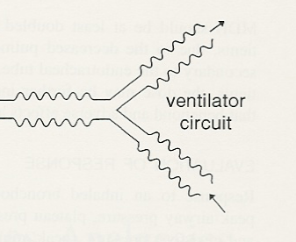
Anything placed between the wye connector and the artificial airway is mechanical deadspace and can cause rebreathing of CO₂

Slide 70
Example of Mechanical V_{d}
Your patient is a 70 kg IBW (150 lb) male on CPAP of 5 cm H₂O with measured spontaneous V_{t} of 280 mL and a rate of 25. How much effective ventilation does this patient really have?
  Anatomical V_{d} = 1mL/lb or 150 mL
  Alveolar V_{d} = 0
  HME Deadspace = 75 mL
  Closed suction Deadspace = 10 mL
  Capnography adapter Deadspace = 10 mL
Answer = [280 – (150 + 75 + 10 + 10)] = 35 mL
(Wonder why he’s not weaning?)

Slide 71
Don’t forget to Compensate For Circuit Compliance
Most newer ventilators either:
  Compensate for lost volume
  Measure volume at the wye connector (pneumotach)
Servo I, Drager XL, NPB 840 all correct for lost volume correctly “IF”…
    …the circuit and humidifier on the ventilator are warmed up before “Pre-use Check” is done
    …proper humidification device is input on start up

Slide 72
Don’t forget to Compensate For Circuit Compliance
If the ventilator does not compensate for lost volume in circuit (example: Servo 900C, Servo 300A, home ventilators, VIP Bird) then the set volume must be corrected for lost volume in the circuit:
Patient volume = set volume – lost volume

Slide 73
Process to Compensate For Circuit Compliance
1. Calculate compliance factor:
  The ventilator circuit is omLluded
  A volume is delivered to the circuit (100 – 150 mL)
  The pressure is measured
  The factor is calculated = Volume / Pressure
  Usually 2 – 4 cm H₂O for adult circuit
2. Calculate lost volume = (PIP – PEEP) x C.F.
  Tubing compliance factor is the volume lost in circuit with every cm H₂O of ventilating pressure
3. Calculate patient volume = Machine delivered volume – lost volume

Slide 74
Example of lost volume in circuit
20 kg, 7 year old patient
Patient needs delivered volume of 20 x 10 = 200 mL
Machine volume set at 200 mL
Actual volume delivered to lungs only 125 mL
WHY?
---------------------------------------------------------------------------
Tubing compliance factor 3.0 mL/cmH2O
Ventilating pressure 25 cmH2O
  Lost volume in circuit is 25 x 3.0 = 75 mL
  Set (200) – Lost (75) = 125 mL delivered to patient
Correct problem by readjusting set machine volume to 275mL

Slide 75
Changing Respiratory Rate
Normal spontaneous rate
  10 – 20 b/min.
Normal ventilator back-up rate
  8 – 12 b/min.
Apnea ventilator back-up rate
  minimum acceptable minute ventilation

Slide 76
Changing Respiratory Rate
Increasing rate should improve PaCO₂.
  V_{t} x f = MV
  If rate is increased & PaCO₂ does not decrease:
    Check for proper V_{t} or PIP
    Look for excessive mechanical deadspace
    Decrease alveolar deadspace

Slide 77
Changing Respiratory Rate
Precautions:
  Do not allow rate to increase too much
  High A/C rates > 20/min. can lead to air trapping
    Consider change to SIMV if rate high and air-trapping in AC
  Rate alarms guidelines:
    set at levels appropriate for the patient

Slide 78
Watch Patient Synchrony
Trigger problems
Change from pressure to flow to NAVA triggering (if available).
Adjust flow triggering properly.
Check system for leaks.
Always use Aero Neb, MDI or intermittent flow with nebulizer breathing treatments.
Get rid of air-trapping and Auto-PEEP.

Slide 79
Watch Patient Synchrony
Add Applied PEEP:
  If there is uncorrectable auto-PEEP and the patient is having difficulty triggering then consider adding applied PEEP.
    Adds PEEP to the circuit.
    Initial setting 50% of auto-PEEP.
    Increase to 80% of auto-PEEP as needed.
    Stop if increase in PIP is observed.
  Applied PEEP may also help empty the lungs by keeping airways from closing prematurely (2 – 3 cm H₂O).

Slide 80
Watch Patient Synchrony
Inspiratory problems:
  Set inspiratory flow to meet or exceed patient demand
  Typical flow pattern is decelerating
  Be sure the rise time is set properly
  Are there early scoops or spikes?
    Be sure the waveform & peak flow match the patient’s needs

Slide 81
Watch Patient Synchrony
INSPIRATORY TIME:
Adult 0.8 – 1.2 seconds
Child 0.6 – 0.8 seconds
Infant 0.3 – 0.5 seconds
Smaller volumes in adults require shorter times
Don’t flow starve your patient!!!

Slide 82
Watch Patient Synchrony
Cycle problems:
Spikes at end of breath?
  T_{i} too long.
  Volume too large.
Set E sens% properly in pressure support
  COPD tend to like higher E Sens% settings.
Watch for scoops and double trigger.
  V_{t} may be too low.
  End flow may be too low (try sign or square wave).
  E sens% may be too high.

Slide 83
Allow For Spontaneous Breathing
Decrease sedation
Changing from complete support to a partial support mode (SIMV or Bi-Level) may:
  Normalize blood gases
  Increase patient comfort
  Recondition respiratory muscles
  Decrease air trapping
Use “Dual Mode” pressure ventilation
  (PRVC, Auto-flow, VC+)
Utilize pressure support and ATC where indicated.
  What is the difference between PSV & ATC?

Slide 84
Pressure Support
LOW LEVEL - PS <10 cm H₂O usually used for overcoming system airflow resistance similar to ATC.
MOD. LEVEL - Begin at 60%- 80% of plateau pressure for spontaneous breathing.
  Usually 10 - 15 cm H₂O
  Titrate PS to acceptable rate & V_{t}
HIGH LEVEL - Beginning at 80% - 100% of plateau pressure is for Psmax (usually >15 cm H₂O)
  NOTE: Be sure to set rise time & E% sensitivity properly

Slide 85
Tracheal Gas Insufflation
A continuous flow of 100% oxygen at 6 L/min is delivered through a small catheter placed through the ET tube 1 cm above the carina.
  A method of expiratory flushing of proximal deadspace gas during mechanical ventilation.
  Used as an adjunct during low tidal volume ventilation to clear CO₂ (may allow for less severe hypercapnia).
  Most effective when increased CO₂ is due to increased deadspace (V_{d}/V_{t} ratio and mechanical).

Slide 86
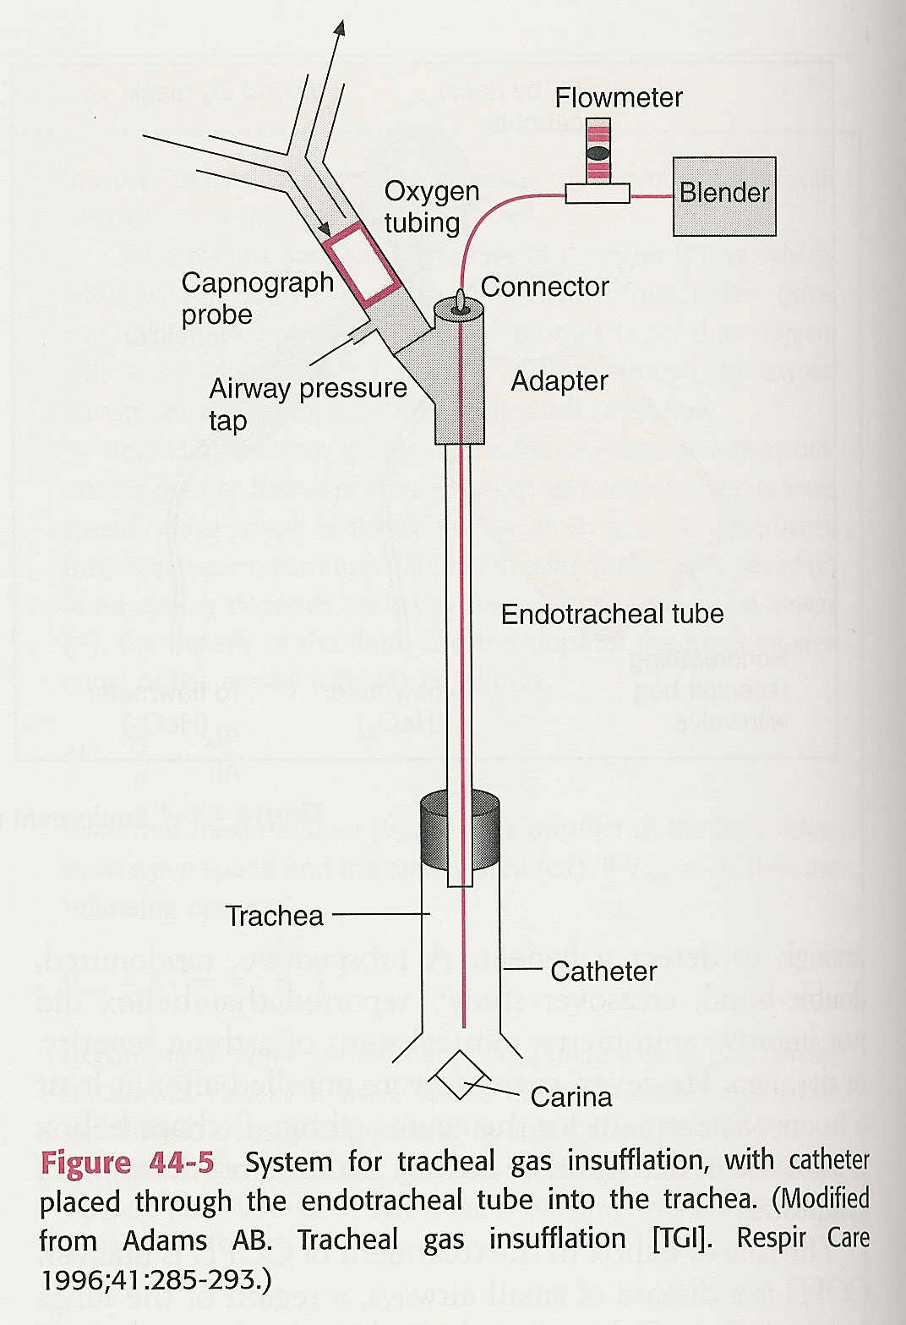
Tracheal Gas Insufflation (TGI)

Slide 87
TGI Complications
Increased volume delivery, PIP & MAP. (increased PaO₂?)
Potential for barotrauma & cardiovascular compromise.
Potential for bronchial mucosal damage from catheter & gas flow.
Potential for inspissation & retention of secretions with long term use.

Slide 88
Optimize Ventilation
  Provide therapeutics
  Change modes
  Adjust tidal volume
  Reduce physiologic deadspace by eliminating auto-PEEP
  Reduce mechanical deadspace
  Correct for circuit volume loss
  Adjust rate
  Maintain patient ventilator synchrony
  Allow for spontaneous breathing

Slide 89
MODES

Slide 90
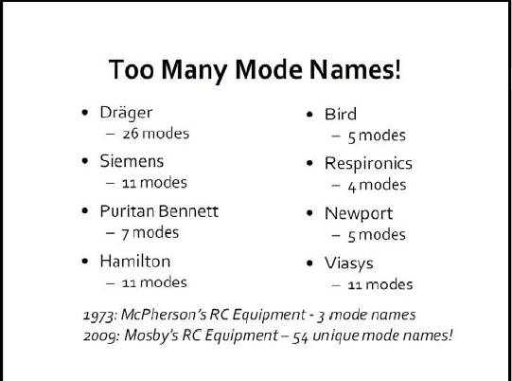

Slide 91
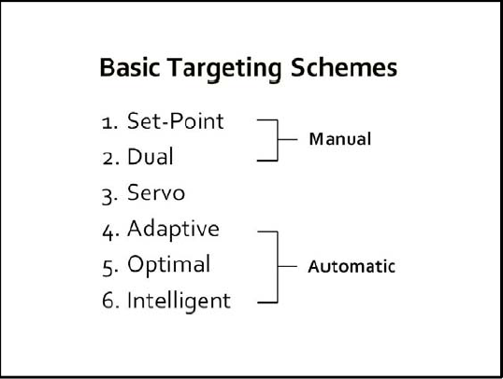
New Form of Ventilator Classification

Slide 92
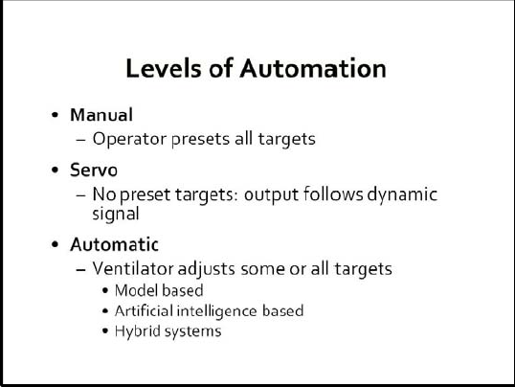

Slide 93
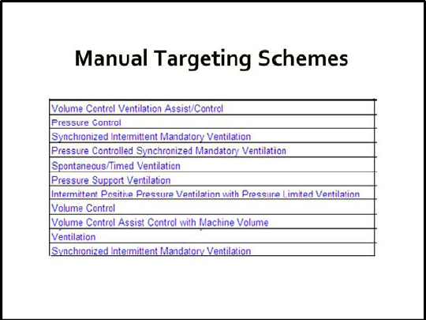

Previously discussed modes
Volume Assured Pressure Support (Dual)

Slide 94
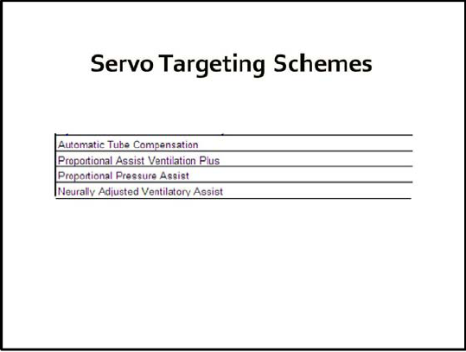

Slide 95
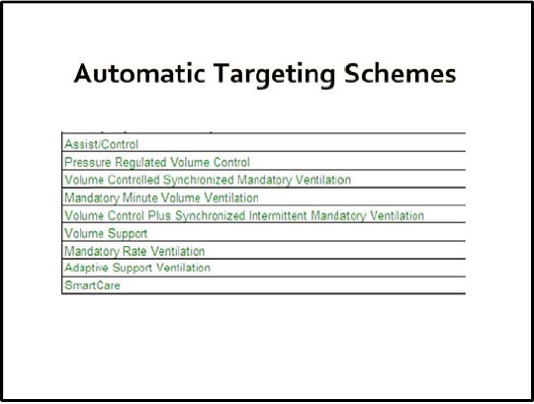
AutoMode

Slide 96
Modes to Discuss
Manual Targeting Scheme
  Set Point
    Assist control volume ventilation (A/C VCV or CMV-VCV)
    Assist control pressure ventilation (A/C PCV or CMV-PCV)
  Dual
    VAPS – Within a Breath
Automatic Targeting Scheme
  PRVC, Auto-flow, VC+, APV, VPC - Breath to breath - time cycled
  Volume Support, Smart Care - Breath to breath - flow cycled
  AutoMode
  Smart Care
Servo Targeting Scheme
  PAV

Slide 97
Volume Ventilation
Volume Control Choices
  C - Control
  AC - Assist-Control (CMV)
  A - Assist
  IMV – Intermittent Mandatory Ventilation
  SIMV – Synchronized Intermittent Mandatory Ventilation
  MMV – Mandatory Minute Ventilation

Slide 98
Volume Ventilation
 | Normal | Increase Cs | Decrease Cs | Increase Raw
Pr
Flow
Vol

Slide 99
Volume Ventilation
 | Normal | Increase Cs | Decrease Cs | Increase Raw
Pr | Variable
Flow | Set
Vol | Set

Slide 100
Pressure Ventilation
OTHER Pressure choices:
  IPPB
  Pressure Support
  ATC
  P-max
  Bi-PAP
  Bi-Level
  APRV
  PRVC
  AUTOFLOW
  VC+
  VS
  AUTOMODE
  SMART CARE
  PAV
  PPS
  ASV
  VAPS
  APS
Pressure Control Choices
  Control
  Assist-Control
  Assist
  IMV
  SIMV
  MMV

Slide 101
Pressure Ventilation
 | Normal | Increase Cs | Decrease Cs | Increase Raw
Pr
Flow
Vol

Slide 102
Pressure Ventilation
 | Normal | Increase Cs | Decrease Cs | Increase Raw
Pr | Set
Flow | Variable
Vol | Variable

Slide 103
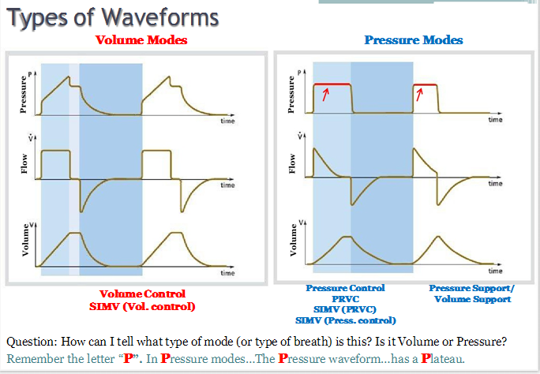

Slide 104
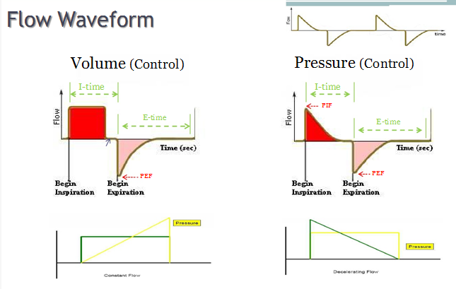

Slide 105
New Modes
Dual Modes
  Within a breath: VAPS
Automatic
Breath to breath - time cycled: PRVC, Auto-flow, VC+, APV, VPC
Breath to breath - flow cycled: Volume Support, Smart Care (Drager)
Servo
PAV (NPB 840)

Slide 106
Dual Targeting Scheme
“within a breath”

Slide 107
Dual Targeting Scheme
(within a breath)
1. VAPS – Volume Assured Pressure Support
  (T-BIRD, 8400st)
2. PA - Pressure Augmentation (Bear 1000)
DEFINITION: Pressure support breath with volume control back-up if desired tidal volume is not met.

Slide 108
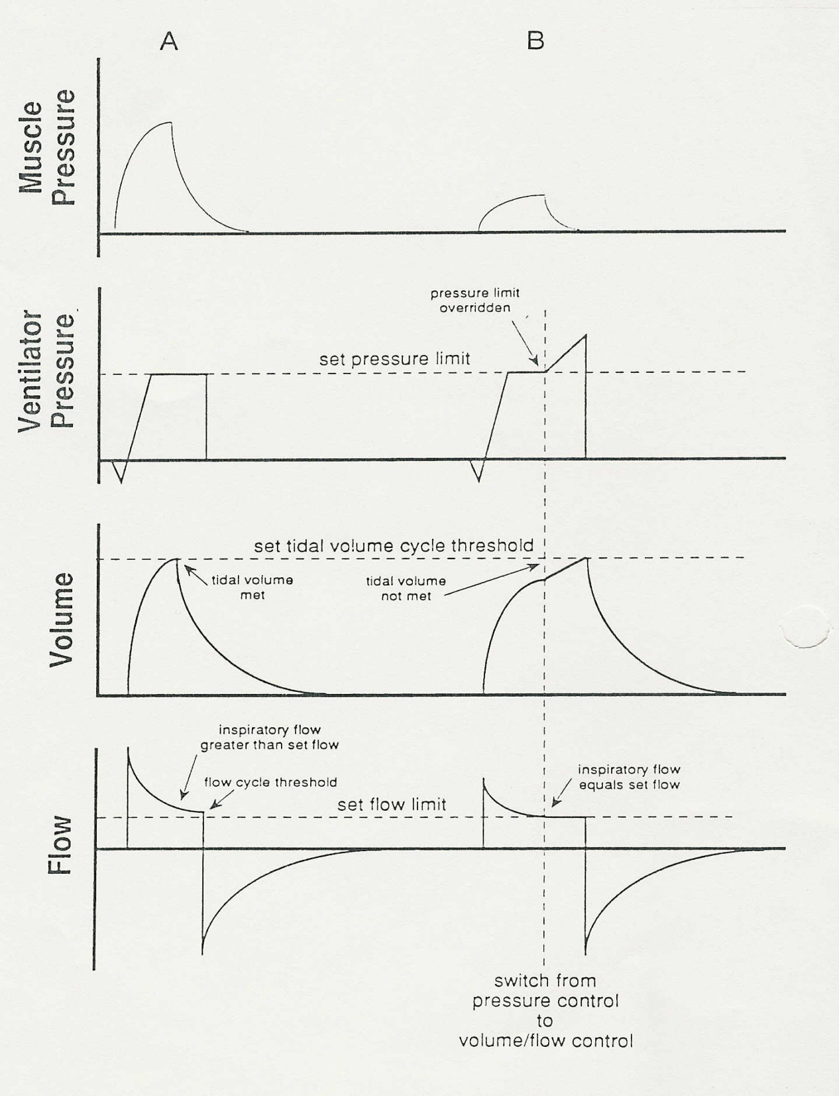
Dual Targeting - within one breath
Pressure Supported breath
  Patient effort high
  Pressure met
  Volume delivered
  Flow Cycled
B. Switch from pressure support to flow control
  Patient effort low
  Pressure met/exceeded
  Volume not initially delivered
  Volume Cycled

Slide 109
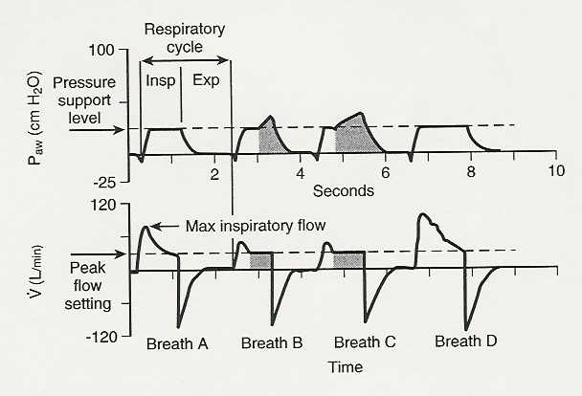
Switch to Volume Ventilation
Flow cycle
VAPS – Variations in breathing pattern

Slide 110
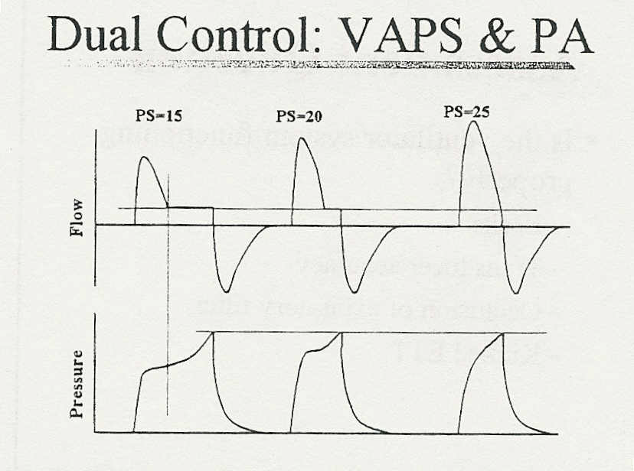

Slide 111
Dual Targeting Scheme
(within a breath)
Advantages
  Guaranteed tidal volume in pressure support and A/C mode.
  Less work of breathing than volume control.
  Could improved synchrony more than VCV.
Settings
  Minimal V_{t}.
  High pressure alarm.
  In PS portion - Pressure support level.
  In AC portion - Peak flow, rate & pressure limit.

Slide 112
Dual Targeting Scheme (within a breath)
Breath type – machine and/or supported
Trigger to inspiration – machine (time) or patient (flow or pressure)
Inspiratory Phase:
    Volume – set minimum target
    Pressure – PS level set & high pressure limit set
    Rate – machine rate set
    T_{i} & T_{e} – machine breaths
    Flow – Machine (set) & Pressure Support (variable)
    Waveform –Machine (square) or PS (variable)
    I:E – variable
Cycle to exhalation – Machine (volume) and Spon. (flow)

Slide 113
Dual Targeting Scheme
(within a breath)
Pitfalls
  If PS too high – all breaths are PSV breaths with possibly an excessive tidal volume.
  If Peak flow set too high – breaths will convert to volume ventilation too soon and all breaths will be volume cycled.
  If peak flow too low – asynchrony can occur when T_{i} becomes too long.
  Pressure can become excessive when switch to volume control occurs.

Slide 114
VAPS – Variations in breathing pattern

Slide 115
RSPT 2335
Mechanical Ventilation
Module C
MANAGEMENT LESSON #1
COPD

Slide 116
MODULE C
Major Topics
COPD Summary
Non-invasive Strategies
Invasive Strategies
Dual Modes Ventilation
Scenario & Case Studies

Slide 117
What we already know…
Emphysema
COPD SUMMARY

Slide 118
Non-invasive Management Strategies:
Long Term Oxygen Therapy (LTOT)
  Low flow (nasal cannula) & high flow (NC or AEM )
Patient positioning (head up, tri-pod)
Aerosol therapy
  Beta 2 agonists, anticholinergics, methylxanthines, inhaled steroids
Bronchial hygiene
  PEP Therapy, Acapella, flutter, vest…
Vaccines & antibiotics (as needed)
Pulmonary Rehabilitation
  exercise, education, nutrition, smoking cessation…
NIPPV

Slide 119
Invasive Management Strategies:
Surgery
Decrease metabolism (CO₂ production)
C. Improve perfusion
D. Optimize ventilation

Slide 120
Circle of Ventilation
Metabolism: temp., activity, nutrition, drugs, seizures…
Tissue
Decrease Production
Lungs
Improve Removal
Blood
Improve Carrying
Increase rate,
Eliminate auto-PEEP,
Spontaneous breathing,
Therapeutics,
Increase tidal volume,
High frequency vent.
Dissolved + HB
Buffering
Heart
Improve Pumping
Poor perfusion leads to CO2 retention at tissues

Slide 121
Optimize Ventilation
  Provide therapeutics
  Change modes
  Adjust tidal volume
  Reduce physiologic deadspace by eliminating auto-PEEP
  Reduce mechanical deadspace
  Correct for circuit volume loss
  Adjust rate
  Maintain patient ventilator synchrony
  Allow for spontaneous breathing

Slide 122
New Modes
Dual Modes
  Within a breath: VAPS
Automatic
Breath to breath - time cycled: PRVC, Auto-flow, VC+, APV, VPC
Breath to breath - flow cycled: Volume Support, Smart Care (Drager)
Servo
PAV (NPB 840)
NAVA

Slide 123
Dual Targeting Scheme
“within a breath”

Slide 124
Switch to Volume Ventilation
Flow cycle
VAPS – Variations in breathing pattern

Slide 125
Automatic Targeting Scheme
“breath to breath”

Slide 126
Automatic Targeting Scheme
(breath to breath)
Pressure limited & Time cycled with
volume guarantee
Pressure limited & Flow Cycled with
volume guarantee

Slide 127
Automatic Targeting Scheme
(breath to breath)
1. Pressure limited & Time cycled with volume targeted
  PRVC – Pressure Regulated Volume Control (Servo i)
  Auto-flow – (Drager)
  VC+ - Volume Control Plus (NPB 840)
  APV – Adaptive Pressure Ventilation (Hamilton Galileo)
  VPC – Variable Pressure Control (Venturi Vent)

Slide 128
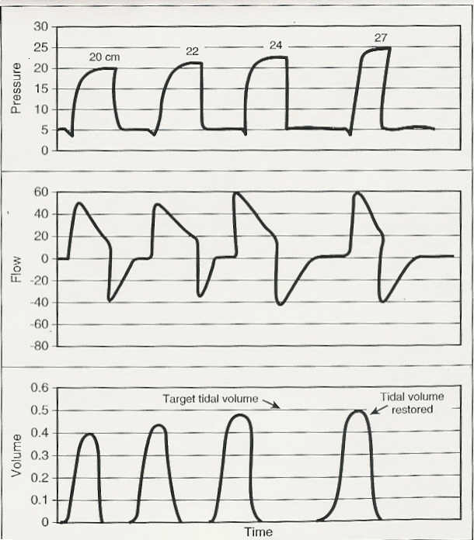
Automatic Targeting Breath to breath
What is seen on start up or with decreasing compliance or increasing resistance.
Pressure increases 1 – 3 cm H₂O per breath to target V_{t} or maximum pressure.

Slide 129
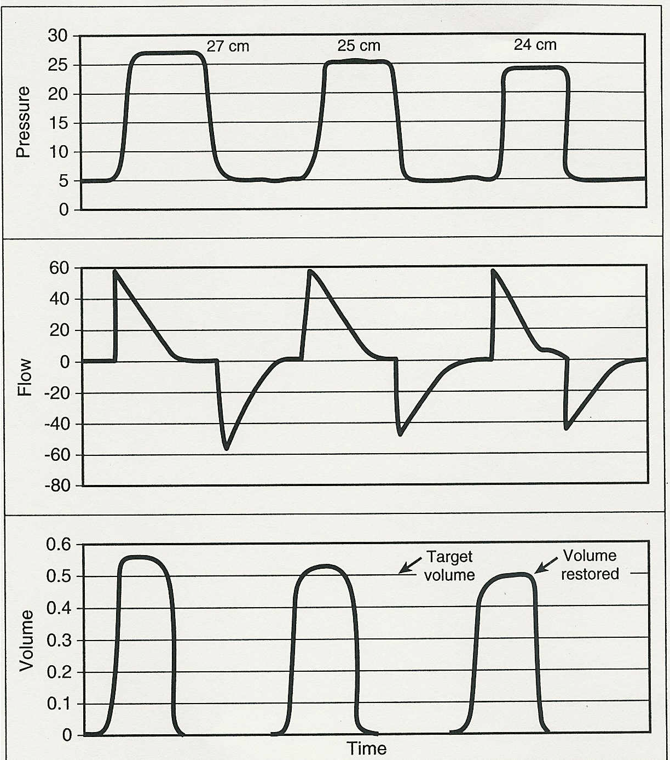
Automatic Targeting Breath to breath
Effects of improving compliance or improving resistance
Pressure decreases 1 – 3 cm H₂O per breath to maintain target V_{t}.

Slide 130
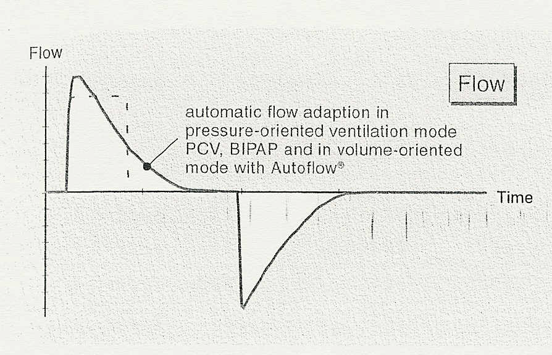
Drager – With Auto-flow turned on there is an automatic change to decelerating flow and free breathing

Slide 131
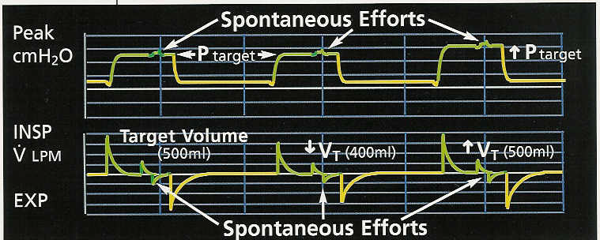
Volume Control Plus or Auto-flow (CMV or IMV)
Assist control
Pressure ventilation with target volume and maximum pressure limit
Machine pressure level change (#3) caused by tidal volume change
Spontaneous efforts are possible during mandatory inspiration

Slide 132
Automatic Targeting Scheme
(breath to breath)Time-cycled
Advantages
  Targeted tidal volume in pressure ventilation.
  Automatic weaning of pressure level to lowest setting needed to maintain V_{t}.
Settings
  Minimal V_{t} & Max. V_{t} (if available).
  High pressure alarm (machine can increase pressure to 5 cm H₂O below this point).
  Frequency, pressure limit & inspiratory time.

Slide 133
How to set up
PRVC, VC+ & Autoflow
  Mode – machine (CMV or SIMV). *
  Trigger to inspiration – machine or patient (flow or pressure).
  Inspiratory Phase:
    Volume – target set with minimal variation.
    Pressure – Maximum set but otherwise varied by machine to maintain Vt or minute ventilation (limit and alarm).
    Rate – minimum set.
    Ti – set.
    Flow – variable.
    Waveform – variable.
    I:E – variable.
  Cycle to exhalation
    Should be time.
    Will be pressure if pressure > high pressure alarm setting.
      “Volume not constant” alarm will activate

Slide 134
ALARM: “Volume not constant”
What causes it?
  Changes in compliance, resistance, secretions…. Anything requiring a higher pressure to deliver the set volume target.
  Set volume cannot be delivered within the pressure limit that is set by the practitioner
  Pressure limit is usually 3 – 5 cm H₂O below the high pressure alarm setting

Slide 135
ALARM: “Volume not constant”
What can be done?
  Check for tube placement
  Check breath sounds
    Secretions
    Wheeze
    Absent (effusion, pneumothorax)
  Check for increased auto-PEEP
  Check for agitation
  Decrease the VT
  Increase the pressure

Slide 136
Automatic Targeting Scheme
(breath to breath) Time-cycled
Pitfalls
  If patient demand increases (V_{t} increases) due to disease or agitation the ventilator will decrease support. In this instant the patient actually needs more support. (runaway)
  Reductions in pressure associated with improved compliance may cause oxygenation to decrease as mean airway pressure falls.
  With disconnect some ventilators begin the ramping process over (840 does not).

Slide 137
Automatic Targeting Scheme
(breath to breath)
2. Pressure limited & Flow Cycled with volume targeted
  VS – Volume Support (Servo 300 & NPB 840)
  VPS – Variable Pressure Support (Venturi)
  Smart Care - Drager

Slide 138
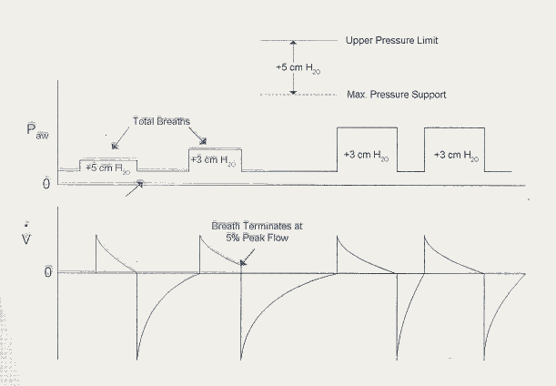
Volume Support
Pressure support with volume target & maximum pressure

Slide 139
Automatic Targeting Scheme (breath to breath) Flow-cycled
Advantages
  Targeted tidal volume in pressure support
  Automatic weaning of PSV as patient is able to assume more WOB

Slide 140
Automatic Targeting Scheme
(breath to breath) Flow-cycled
Settings
  Minimum tidal volume (may actually set by minute volume/frequency controls on Servo i)
  High pressure alarm (ventilator can increase pressure support to 5 cm H₂O below this value)
  Frequency and tidal volume settings need to be based on proper values for this patient.
    Minimum rate
    NOTE: On some vents tidal volume may increase up to 150% of set to maintain minute ventilation in the face of low rate.

Slide 141
Automatic Targeting Scheme
(breath to breath)
  Breath type – Spontaneous Supported
  Trigger to inspiration – Patient
  Cycle to exhalation
    Should be flow cycled
    Back-up cycle
      Will time cycle at 80% of TCT
      Will pressure cycle if machine reaches 5 cm H₂O above high pressure limit

Slide 142
Automatic Targeting Scheme
(breath to breath)
Inspiratory Phase:
    Volume – minimal variation (can increase if f decreases to maintain V_{E}).
    Pressure – Maximum set but otherwise varied by machine to maintain V_{t} or minute ventilation.
    Rate – a target rate is set and if patient rate is < target rate, the machine will increase PS level to increase V_{t} (up to 150%) and maintain V_{E}.

Slide 143
Automatic Targeting Scheme
(breath to breath)
Inspiratory Phase:
    T_{i} – set
    Flow – variable
    Waveform – variable
    I:E – variable

Slide 144
Automatic Targeting Scheme
(breath to breath) Flow-cycled
Pitfalls
  Patient’s may chose to do minimal work and remain at set V_{t}.
  The PSV level required to maintain a tidal volume may result in auto-PEEP if patient becomes tachypneic.
  If patient demand increases (increased V_{t}) due to agitation or disease, the ventilator decreases support. In this case, the patient actually needs more support. (runaway)
  If sedation reduces patient respiratory rate or auto-PEEP prevents triggering, a tidal volume of up to 150% of the set volume may be delivered. This may lead to volutrauma or barotrauma.

Slide 145
Automatic Targeting Scheme
“combinations”

Slide 146
Automatic Targeting Scheme
(combinations)
Pressure Limited & Flow Cycled combined with Pressure Limited & Time Cycled with a volume guarantee
  Automode – (Servo 300A)
  Ventilator is pretty much retired.

Slide 147
Automatic Targeting Scheme Smart Care - Drager
Similar to volume support.
  Adjusts ventilation to maintain patient in “Zone of Respiratory Comfort” (ZORC).
  Ventilation adjustments based on patient rate, tidal volume, PetCO₂, disease, IBW.
  “Disease Classifications” include: Neurological, COPD & normal.

Slide 148
Let’s do SmartCare Lab together.

Slide 149
MODES

Slide 151
Servo Targeting Scheme
Proportional Assist Ventilation (PAV+)
  Watch Puritan Bennett DVD (8 minutes)

Slide 152
PAV+ (NPB 840)
Proportional Assist Ventilation (PAV+)
  Pressure ventilation: patient triggered, pressure limited & flow-cycled breaths (PS).
  Clinician sets % support (5 – 95%).
    Higher % support = less patient WOB.
  Monitors “Equation of Motion” and adjusts ventilation for changes in:
    compliance
    resistance
    patient effort
  Not for use with low or abnormal respiratory drive, extreme air-trapping, and moderate to large leaks.

Slide 153
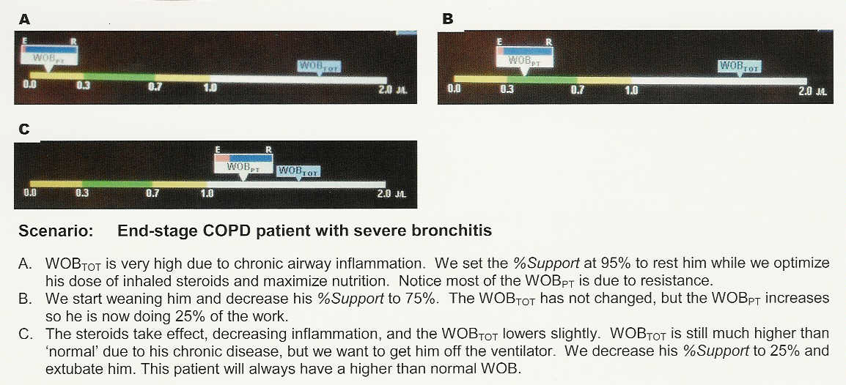
NPB 840 Case Study

Slide 154
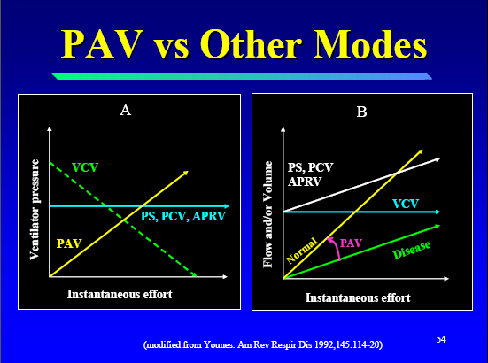

Slide 155
ASV – Adaptive Support Ventilation
Based on the Arthur Otis- “Minimum WOB Concept”.
  Switches ventilator from AC-PC to SIMV-PC with PS to PS ventilation.
  Maintains ventilation and oxygenation, and minimizes work based on compliance, Raw and PEEPi measurement.
  RT inputs IBW, V_{E}, %V_{E} control, PEEP, FiO₂, Rise time, flow cycle & high alarm.

Slide 156
Dual Mode Lab Exercise
Performance Evaluation:
  PRVC, VC+, Autoflow
  VS
Practice on your own and at clinic:
  Smart Care
  PAV

Slide 157
PRACTICE
Lab Exercise: Modes
  NPB 840 (CMV – VC+ - VS)
  Drager XL (AUTOFLOW)
  Servo I (PRVC – VS)
Performance Evaluation:
  PRVC, VC+, Autoflow
  VS

Slide 158
Instructor - Scenario #4
Acute Exacerbation of Chronic Airway Obstruction.
  Patient IBW is 63kg
  Square wave flow _____L/sec ____L/min.
  V_{t} _____L
  PIP _____ cm H₂O
  P_{plat} _____ cm H₂O
  PEEP ____ cm H₂O
  Rate ______ bpm

Slide 159
Case studies
Read – Pilbeam
  Case study #5 on page 76
  Case study page 137

Slide 160
ICS - 11
Janice Wyant – 70 year old COPD patient who recently underwent percutaneous biopsy for chest lesion

