Slide 1
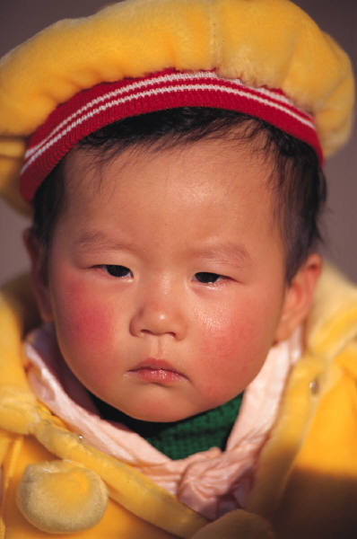

RSPT 2335
Mechanical Ventilation
Module D
Neonatal & Pediatric Ventilation

Slide 2
MODULE D
Resources
Reading Pilbeam: Chapter 22
DVD: HFOV

Slide 3
AARC Clinical Practice Guidelines
Evidence-based clinical practice guideline: Inhaled nitric oxide for neonates with acute hypoxic respiratory failure (2010).
Surfactant replacement therapy (2013).
Humidification during invasive and non invasive mechanical ventilation (2012).
Transcutaneous blood gas monitoring for neonatal and pediatric patients (2012).
Capnography/capnometry during mechanical ventilation (2011).
Endotracheal suctioning of mechanically ventilated patients with artificial airways (2010).
Application of continuous positive airway pressure to neonates via nasal prongs, or nasopharyngeal tube, or nasal mask (2004).
Capillary blood gas sampling for neonatal and pediatric patients (2001).

Slide 4
MODULE D
Objectives
When you complete this module, you should be able to…
  List the normal vital signs and abg values for infants & pediatric patients
  List the indications for CPAP in the newborn
  List the indications for intubation of the newborn.
  List the indications for mechanical ventilation of the newborn.

Slide 5
MODULE D - Objectives
When you complete this module, you should be able to…
  Describe the circuit and humidification requirements for neonatal and pediatric patients.
  Describe the initial ventilator settings used when ventilating a normal lung of the newborn or pediatric patient.
  Compare and contrast neonatal and pediatric ventilation.
  Describe the newer features available for neonatal & pediatric ventilation.

Slide 6
MODULE D
Major Topics
Assessment & Resuscitation
HFNC
C.P.A.P.
  Infant Flow
  Bubble
SiPAP
Conventional Mechanical Ventilation
HFOV & HFJV

Slide 7
Resuscitation of the Newborn
Initial steps:
  Term Gestation? Good Tone? Breathing or Crying?
  “NO” to any – Stabilization under radiant warmer.
    Prevent heat loss (dry & warm). [36.5 to 37.5° C]
    Position, open airway & suction if obstruction present.
      Harm avoidance in meconium-stained, poor tone infants.
    Tactile stimulation to initiate breathing.
    “Golden Minute”
  Evaluate APGAR.
    ECG to evaluate heart rate.
    Respiratory rate and heart rate most important.

Slide 8
Resuscitation of the Newborn
Initial steps (cont.):
  Delay cord clamping.
    Pre-Term and Term for at least 30 seconds if stable.
  Limit oxygen, especially in pre-term.
  Use T-piece resuscitator, flow-inflating, or self-inflating bag and PEEP (< 5 cm H₂O).
    20 cm H₂O initially; may need to increased to 30 to 40 cm H₂O if needed.
  Surfactant early if premature.
  Avoid ETT if possible.
    LMA if 34 weeks or greater.

Slide 9
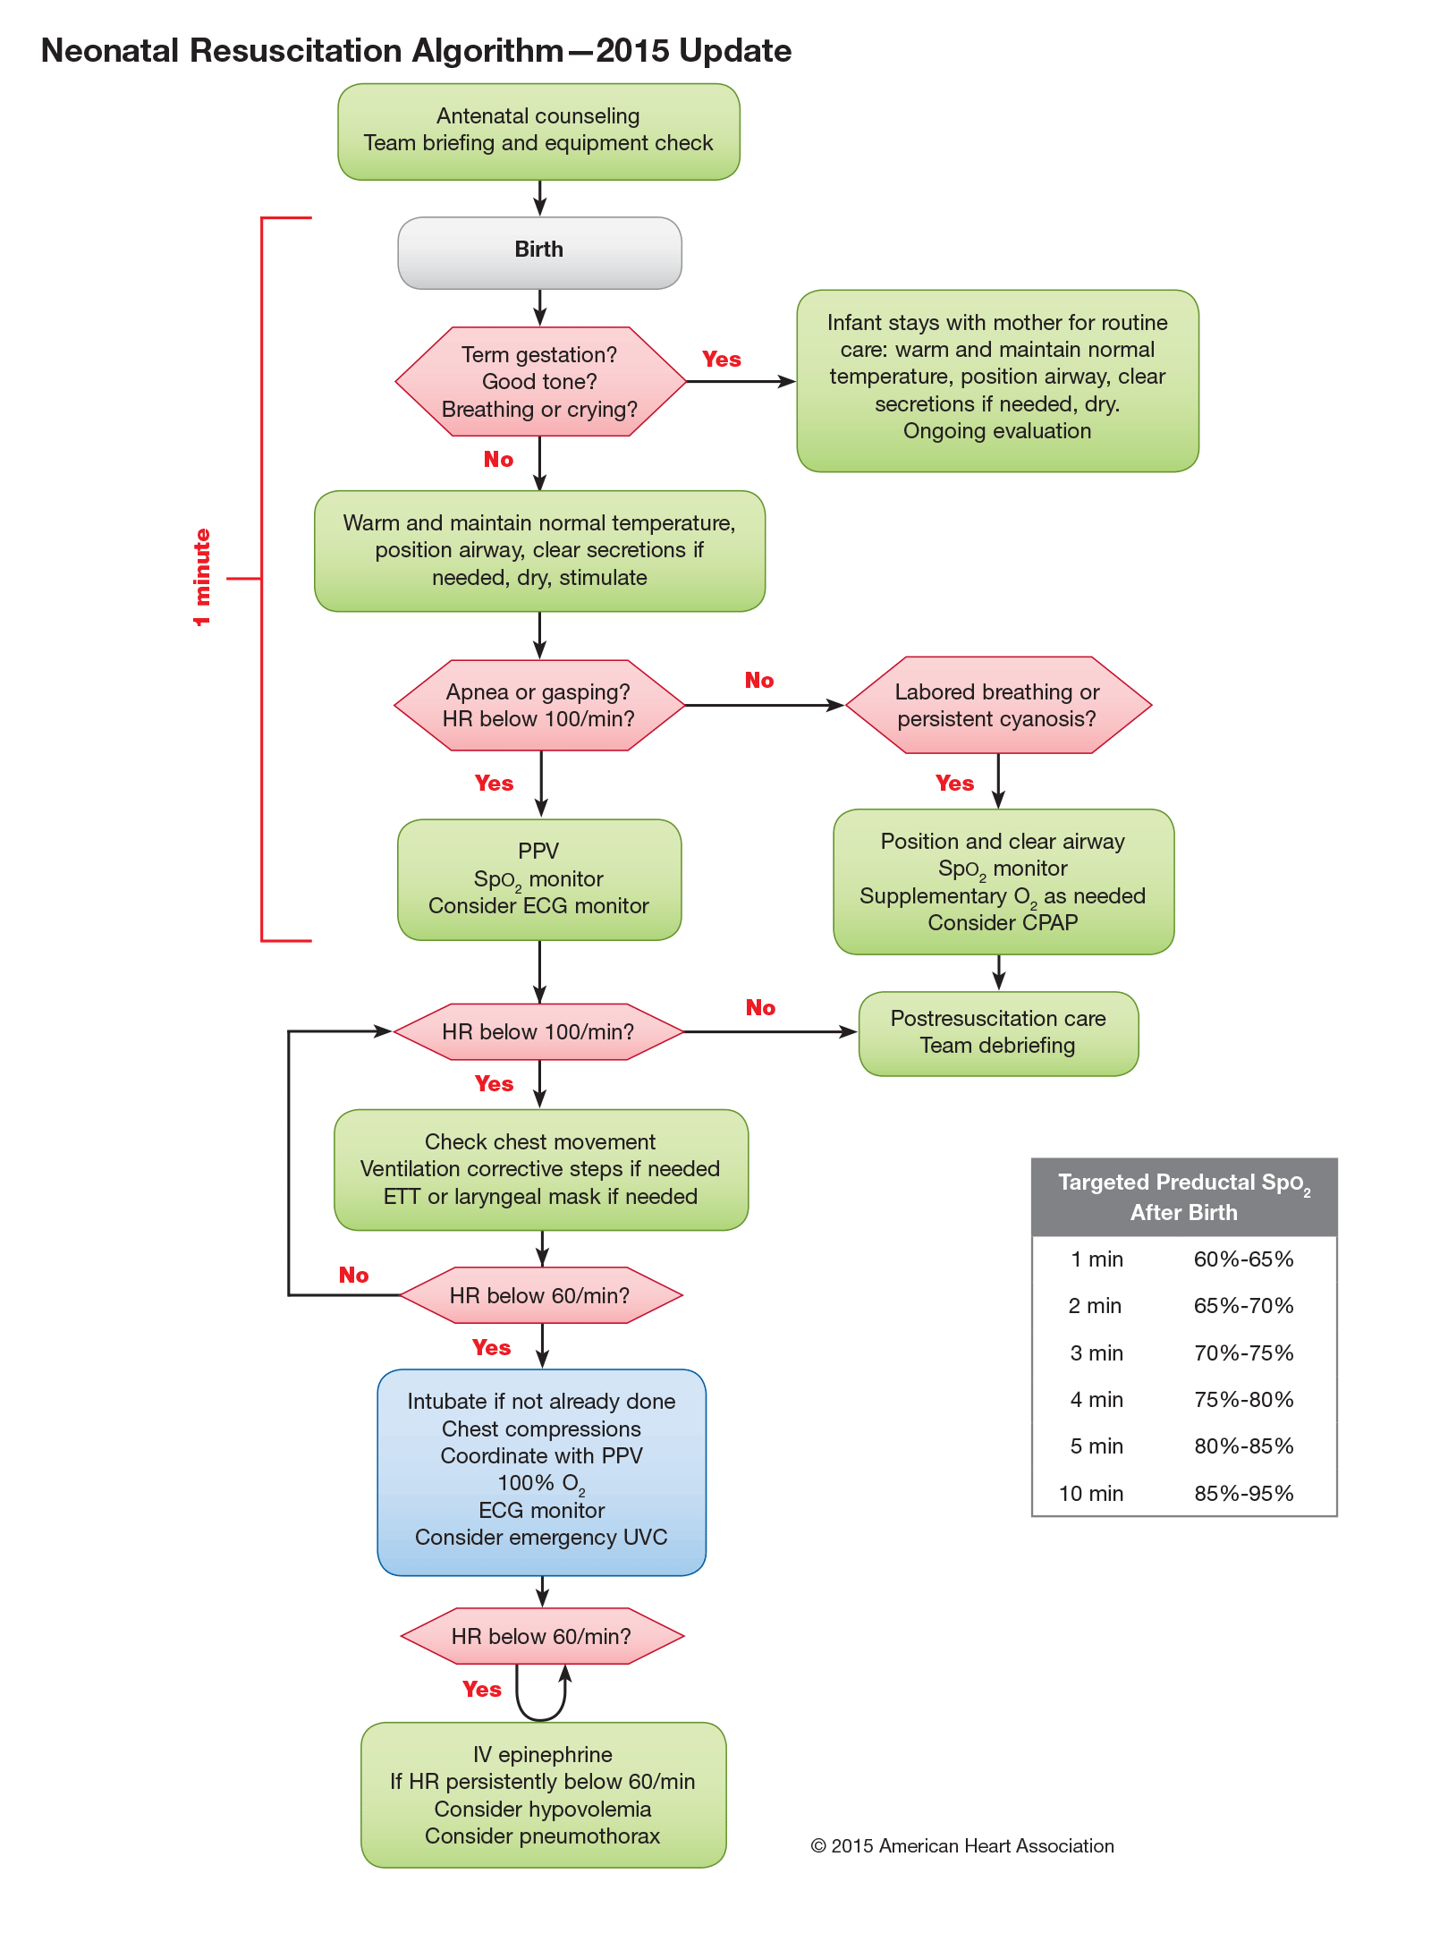
2015 Newborn Resuscitation Algorithm.
Notes:
Newborn Resuscitation Algorithm.

Slide 10
Targeted Pre-Ductal SpO₂ After Birth
Time After Birth | Targeted Saturation
1 minute | 60 to 65%
2 minutes | 65 to 70%
3 minutes | 70 to 75%
4 minutes | 75 to 80%
5 minutes | 80 to 85%
10 minutes | 85 to 95%

Slide 11
APGAR
A = Appearance (color)
P = Pulse rate
G = Grimace (reflex irritability)
A = Activity (muscle tone)
R = Respiratory effort
Scoring:
1 minute indicates neonatal survival
5 minutes indicates neurological damage

Slide 12
APGAR
No depression Score 7 - 10 | Moderate depression Score 4 – 6 | Severe depression Score 0 - 3
Suction mouth & nose. Assure patent airway. Monitor vitals. | Immediate treatment Suction mouth & nose. Assure patent airway. Continuous heart rate monitoring. Tactile stimulation of feet. If HR < 100, bag & mask ventilate. 30 – 40% O₂ & observe for 24 hours. | Emergency treatment Suction mouth & nose. Assure patent airway. Continuous heart rate monitoring. Remove foreign matter from larynx & trachea by suction (ET if needed). Bag & mask ventilate. Start compressions If HR <60 or 60 – 80 without rising on 100% O₂. Transfer to NICU.

Slide 13
Resuscitation
Ventilation: (T-piece resuscitator)
  Neonate 40 – 60/min
  Infant 20/min
  Child 15 – 20/min
Compressions:
  Neonate: ¹/₃ of AP diameter of chest at approximately 120/min, thumbs method preferred, 3:1 compression: ventilation ratio.
  Infant ¾ - 1 inch at 100 – 120 /min, 2 fingers (thumb method for 2-rescuers), 30:2 for one rescuer, 15:2 for 2 rescuers.
  Child ¹/₃ of AP diameter of chest (1 ½ inches) at 100 – 120/min, palm, 30:2 for one rescuer, 15:2 for 2 rescuers.

Slide 14
Normal Values
VALUE | PRE-TERM | TERM | PEDIATRIC
Heart Rate | 120 - 160 | 100 - 140 | 80 - 120
Respiratory Rate | 30 – 60 | 20 - 40 | 18 - 30
Blood Press | 1 kg 50/30 2 kg 60/35 3 kg 65/40 | Sys 64-96 Dias 30-62 | Sys 89-121 Dias 48-66
Temp. | 36.5 – 37.5° C axillary

Slide 15
Blood Gases
 | Birth | Premie | Hours | Days | Child | Adult
pH | 7.30 | 7.33 | 7.34 | 7.30-7.40 | 7.35-7.45 | 7.35-7.45
PaCO₂ | <50 | <47 | 35 | 26-40 | 35-45 | 35-45
PaO₂ | 50–60 | 50-60 | 60-80 | 60-80 | 80-100 | 80-100
HCO₃⁻ | 25 | 22 | 19 | 18-25 | 22-26 | 22-26
BE | -4 | -4 | -5 | -3 | 0 | 0

Slide 16
High Flow Nasal Cannula
Specifically made for oxygen delivery.
High flows may reduce or eliminate entrained room air and decrease inspiratory WOB.
High flows purge end expiratory gas from nasopharynx (deadspace) to provide a ventilatory effect that can accomplish at least 11 – 13% of a patient’s ventilatory work effort (washout of deadspace).
Heats and humidifies the inhaled gases improving lung mechanics, comfort, tolerance and compliance.

Slide 17
HFNC & CPAP
Tight fitting nasal prongs, closed mouths and high flows may cause undesired CPAP.
Prongs should not exceed 50% of internal diameter of nares.
  Not recommended to be used for CPAP.
  Pressure is not being measured or limited.
  Pressures are unpredictable and can be up to as high as 8 cm H₂O.

Slide 18
High Flow Nasal Cannula
Humidifier
  Vapotherm
  Heated passover humidifier
Flow rates
  Vapotherm – determined by cartridge used
    High flow = 5 – 40 L/min
    Low flow = 1 – 8 L/min
  Passover – determined by practitioner
Interface
  Nasal Cannula
    6 sizes: Premature, Neonatal, Infant, Intermediate Infant, Pediatric, and Adult
  Securing device

Slide 19
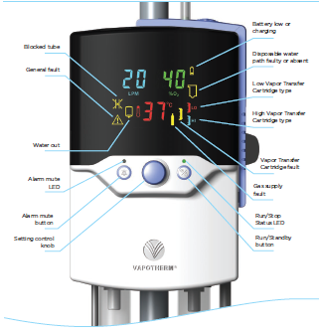

Slide 20
CPAP
Rationale:
  Increase FRC.
    Lung expansion beyond 6th rib anterior.
    Recruit collapsed and poorly ventilated alveoli.
  Decrease VQ mismatch (shunting).
  Improve oxygenation.
  May reduce apnea episodes (reflex stimulation).
  Decrease work of breathing.
    Improve compliance.
    Dilates airways and decreases inspiratory resistance.
    Increase volumes and decrease rates.

Slide 21
Indications for CPAP
Spontaneously breathing infant with respiratory distress at birth.
Atelectasis, pulmonary edema or hemorrhage.
Apnea of prematurity.
Early/post extubation (Intubation, SURfactant, Extubation).
Tracheomalacia.

Slide 22
Contraindications for CPAP
Respiratory failure with elevated CO₂.
Profound apnea.
Upper airway abnormalities (choanal atresia, cleft palate).
Tracheoesophageal fistula.
Diaphragmatic hernia.
Severe cardiac instability.

Slide 23
Complications
Increased work of breathing.
Respiratory failure.
Pneumothorax.
Changes in cerebral blood flow.
CPAP Belly (Stomach distension).
  Consider use of oro-gastric tube.
  Calm infant – consider pacifier.
  Decrease CPAP pressure if possible.
Skin breakdown noted.
  Change interface.
  Loosen straps.
  Correct tubing position.

Slide 24
Limitations
The system will not hold pressure.
  Mask or nasal prong leak.
  Circuit leak.
  Mouth leak (use chin strap or pacifier).

Slide 25
Ideal CPAP System
Simple.
Constant, stable pressure.
Low work of breathing.
Humidification.
Comfortable interface.
  Soft, silicone prongs and masks.
  Flared prongs that don’t need excessive pressure to seal.

Slide 26
Types of CPAP Systems
Infant Flow System
Bubble CPAP

Slide 27
HFNC & CPAP
Tight fitting nasal prongs, closed mouths and high flows may cause unwanted CPAP
Prongs should not exceed 50% of internal diameter of nares
  Not recommended to be used for CPAP
  Pressure is not being measured or limited
  Pressures are unpredictable and can be up to as high as 8 cm H₂O

Slide 28
INFANT FLOW SYSTEM

Slide 29
Advantages
Fluidic Flip Action:
Special nasal piece used fluidics to deliver flow.
Decreases work of breathing by up to 75% over traditional constant flow CPAP systems.
  During inspiration flow is directed towards the patient.
  During exhalation flow is directed away from the patient.

Slide 30
Infant Flow CPAP:
Infant Flow CPAP Video :
  http://www.youtube.com/watch?v=1TwC2d-cXg8

Slide 31
Setting up the equipment.
  Connect power cords to electric outlets.
  Connect air & oxygen hosed to gas sources.
  Connect generator to the patient circuit.
  Connect the filter to the generator gas outlet.
  Connect patient circuit to Infant Flow System.

Slide 32
  SELECT THE PRONGS OR MASK
  Select appropriate size mask or nasal prongs using Nose Guide and attach it to the generator.
    Black dots are infant nares size.
    Clear circles are prong size.
    Use the largest size that will fit the nares.
  SELECT THE BONNET
  Select proper size headgear by measuring head circumference and using Bonnet Size Guide.

Slide 33
  SECURE THE GENERATOR
  Secure the generator on top of the bonnet using the Velcro tie.
  Weave generator straps through bonnet buttonholes starting inside the bonnet with the lowest color-coded buttonhole.

Slide 34
Attach equipment to the patient:
  Turn on the Infant flow system and compressor.
  CHECK FOR LEAKS.
    Set the flow to 8L/min and the FiO₂ to 0.21.
    Occlude the prongs and the CPAP should read 5 cm H₂O. If not – check for leaks.
  Adjust the flow to obtain the desired CPAP reading.
  At this time the humidifier should be off but in a real patient situation it would be set to 36 – 37°C.

Slide 35
Initial Parameters
CPAP typically = 4 – 7 cm H₂O
Continuous flow usually = 5 – 10 L/min

Slide 36
  Gently place the bonnet on the infant’s head; checking ears are in normal position.
  Lift the generator from the top of the bonnet and bring towards the infants nose.
  Gently insert the prongs or mask into position to create a seal and CPAP.
  Secure all three tubings with the central Velcro tie.
  Pull the generator straps gently across the infant’s cheeks to tighten the unit.
  Split the inspiratory and pressure lines and secure with secondary Velcro ties.

Slide 37
  Tie off the top of the bonnet.
  Alarms are automatically set after 2 minutes:
    3 cm H₂O above CPAP.
    2 cm H₂O below CPAP.
    5% above and below FiO₂.
    After making a change, push the ARM/MUTE button for 3 seconds to reset the alarms.

Slide 38
BUBBLE CPAP

Slide 39
Advantages
Safe, simple & easy to use.
Inexpensive.
Single patient use.
Constants CPAP pressure.
Bubbling may enhance ventilation.

Slide 40
Application
For patients </= 10 kg.
Silicone prongs for minimizing skin irritation.
Longer prongs to prevent resting on nasal septum.
Chin strap available.
Nose and circuit bumpers available.

Slide 41
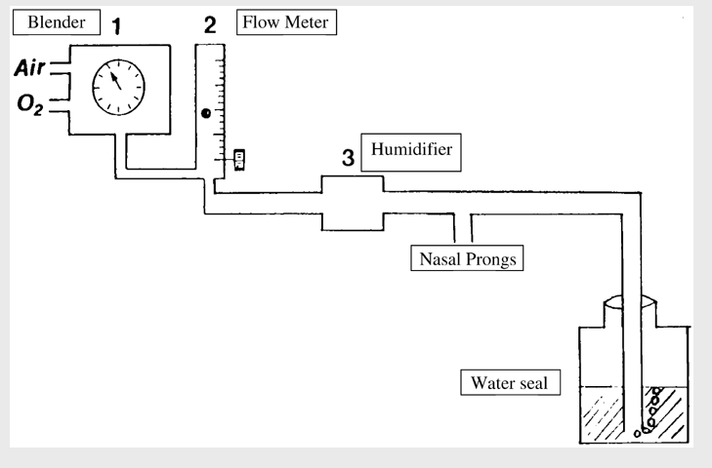
Homemade Bubble CPAP

Slide 42
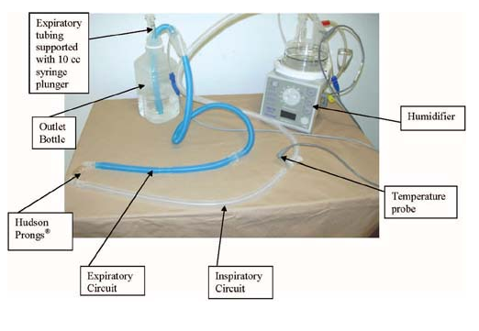

Slide 43
Babi.Plus Bubble PAP Valve
Website for product literature:
  Babi-Plus Bubble CPAP Valve
    http://www.babi-plus.com/bc01.html

Slide 44
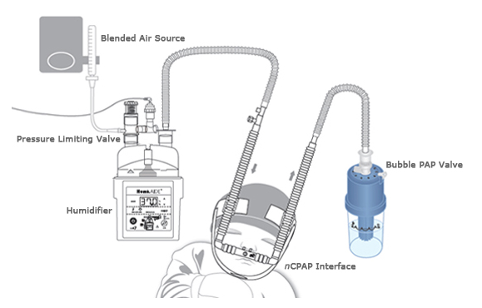

Slide 45
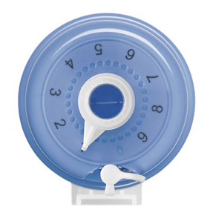
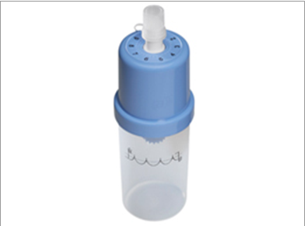
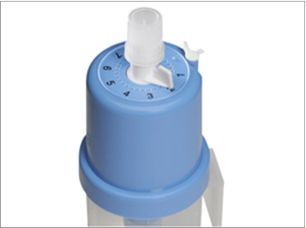
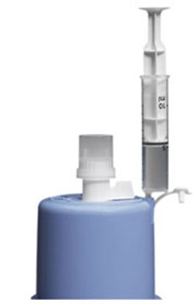

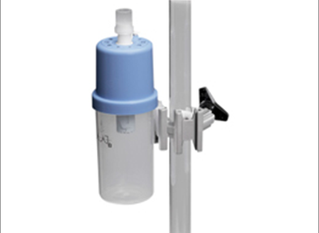
Babi.Plus Bubble PAP Valve

Slide 46
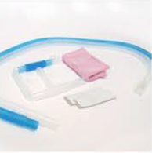
Disposable supplies

Slide 47
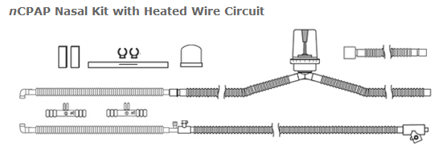

Slide 48
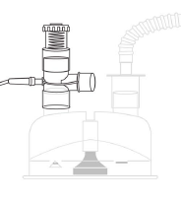
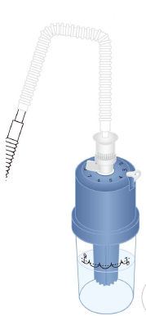
Bubbler & CPAP adjustment
Humidifier & Pop-off

Slide 49
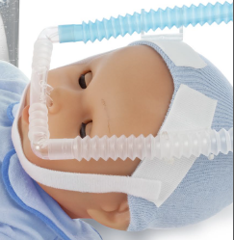
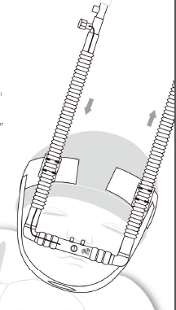
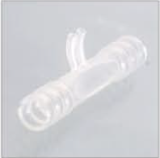
Headgear

Slide 50
The Babi.Plus PAP valve
Only for use with premature infants and infants < 10 KG (about 24 pounds).

Slide 51
The Babi.Plus PAP valve
Select proper size cap & cannula for infant.
Assemble equipment.
Fill bubble with sterile water.
Adjust flow and FiO₂.
Attach to patient.
Monitor.

Slide 52
Initial Parameters
CPAP typically = 4 – 7 cm H₂O.
Continuous flow usually = 5 – 10 L/min.

Slide 53
Monitor the patient every hour:
  Do a visual assessment of WOB, SpO₂, color and tolerance.
  Check the prongs/mask is in position and not causing too much pressure on the nose.
  Be sure the eyes are clearly visible.
  Check the stability of the flow generator.

Slide 54
Monitor the patient every 2 hours:
  Do a visual assessment of WOB, SpO₂, color and tolerance.
  Check the prongs/mask is in position and not causing too much pressure on the nose.
  Be sure the eyes are clearly visible.
  Check the stability of the flow generator.
  Do a physical assessment of vital signs, breath sounds, suctioning prn, ABGs.
  Check the CPAP level, water level, temperature, flowrate and FiO₂.
  Document.

Slide 55
Monitor the patient’s skin every 3-4 hours:
Loosen the ties and remove the generator to inspect the infants face, skin and nasal tissue.
Keep skin clean and dry.
Reassess the fit of the prongs/mask at this time.
Reapply the prongs/mask and bonnet.
Consider alternating between prongs and a mask Q-shift if irritation occurs.

Slide 56
Troubleshooting
System is noisy.
  Add silencer.
  Add expandable tubing.
Secretions are thick.
  Suction only when indicated.
  Check humidity, temperature & water level.

Slide 57
Troubleshooting
Driver is “false” alarming.
  Reset alarm limits by pressing and holding ALARM/MUTE for 3 seconds.
  Driver may require calibration.
Gas failure Alarm.
  Air and Oxygen hoses not connected.
  Inappropriate gas pressures.

Slide 58
SiPAP http://www.youtube.com/watch?v=9lh6Ff5iV84

Slide 59
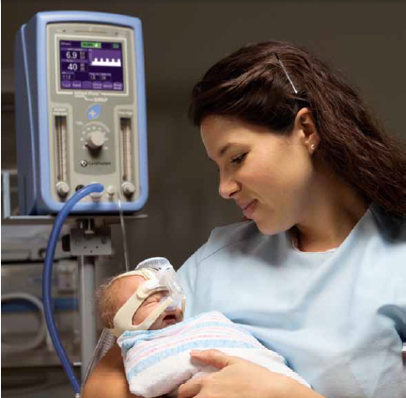

Slide 60
SiPAP
Non-invasive Bi-Level Ventilatory Support.
  Modes:
    NCPAP.
    NCPAP & Apnea (need abdominal sensor).
    Trigger BiPhasic (need abdominal sensor).
    BiPhasic.
    BiPhasic & Apnea (nee abdominal sensor).

Slide 61
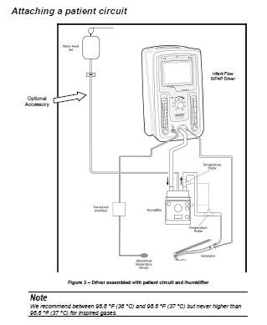

Slide 62
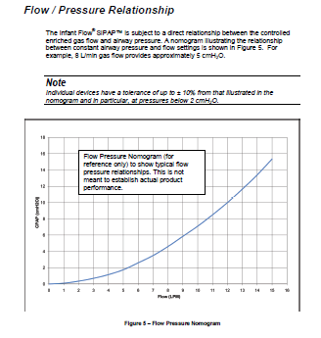

Slide 63
NCPAP
NCPAP – Nasal continuous positive airway pressure using the Infant Flow Generator.
BiPhasic – time triggered.
  Set by the clinician:
    Number of breaths delivered.
    Amount of support.
    Inspiratory time.

Slide 64
NCPAP
NCAP – nasal continuous positive airway pressure using the Infant Flow Generator
NCPAP & Apnea – NCPAP with apnea monitoring and alarm added. Apnea interval is operator selectable.

Slide 65
BiPhasic
BiPhasic – Time triggered.
  Set by the clinician:
    Number of breaths delivered.
    Amount of support.
    Inspiratory time.
BiPhasic & Apnea – BiPhasic with apnea monitoring and alarm are activated.

Slide 66
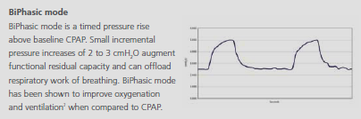

Slide 67
Trigger BiPhasic
BiPhasic tr - Requires Transducer and Grasby Capsule
  Set by patient:
    Breath rate - each time the patient initiates a breath the SiPAP machine will deliver a fully supported breath.
  Set by clinician:
    Level of support
    Apnea interval
    Back up rate

Slide 68
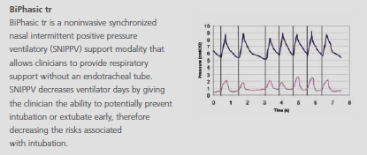

Slide 69
Other features
  Trigger:
    Synchronized with patient trigger (Graseby Capsule).
    Unsynchronized.
  Cycle: Time
  Typical Inspiratory Time </= 0.3 sec.
  Maximum rate = 80 bpm.
  Maximum pressure = 10 - 15 cm H₂O.
  FiO₂ control.
  Baseline CPAP control.

Slide 70
Features
Used the Infant Flow Generator.
Integrated alarms.
2 hour battery life.

Slide 71
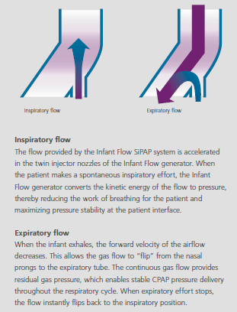

Slide 72
What is SiPAP?
Bi-level nasal CPAP with machine timed triggered “Sighs above CPAP baseline”
  A small (2 – 3 cm H₂O), slow, unsynchronized, intermittent increase in CPAP pressure for a duration of up to 3 seconds to produce a “Sigh”.
  May increase lung volume by 4 – 6 mL/kg.
The infant can spontaneously breath throughout the breath cycle.

Slide 73
What is SiPAP?
Bi-level nasal CPAP with machine timed or patient triggered “Sighs above CPAP baseline”
  A small (2 – 3 cm H₂O), slow, unsynchronized, intermittent increase in CPAP pressure for a duration of up to 3 seconds to produce a “Sigh”.
  May increase lung volume by 4 – 6 mL/kg.
The infant can spontaneously breath throughout the breath cycle.

Slide 74
What will SiPAP do?
  Reduces ventilator days and extubation failure
Recruit lung volume and improve oxygenation
Off-load respiratory work and improve ventilation (BiPhasic)
May stimulate respiratory center

Slide 75
Who will benefit from SiPAP?
Premature infants that don’t require aggressive support.
Infants weaning from mechanical ventilation.
Infants with reasonable compliance.

Slide 76
What does the evidence show?
Studies of nCPAP vs. SiPAP showed:
  a significantly longer need for ventilatory support (6.2 vs. 3.4 days) in nCPAP group.
  A significantly longer dependency on oxygen (13.8 vs. 6.5 days) in nCPAP group.
  Extubation to nCPAP (61% success) vs. Extubation to SiPAP (90% success).

Slide 77
Precautions
Non-synchronized breaths can lead to:
  Opening of esophagus (at 9 – 11 cm H₂O) with gastric insufflation.
  Opening of the mouth (at 9 – 11 cm H₂O) with loss of pressure.
  Humidifier low level causes decreased volume delivery.
  Ti > 0.3 sec. can lead to air trapping.

Slide 78
Pre-Tests
User Verification.
  Automatic with power up.
From “Set up Screen”.
  Calibrate O₂ sensor.
  Leak Test.
  Alarm Test.

Slide 79
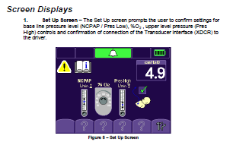

Slide 80
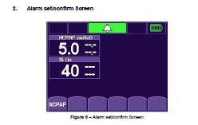

Slide 81
Set Up
Set up pressure levels using flowmeters.
Select FiO₂ with control knob.
Select Mode with “Mode Select Screen”.
Set appropriate parameters for that mode with “Parameter Adjust Screen”.
  Rate
  Inspiratory time
Reset Alarms.

Slide 82
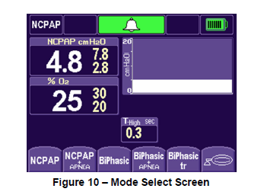

Slide 83
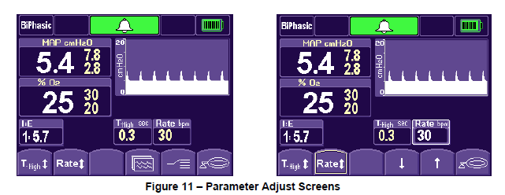

Slide 84
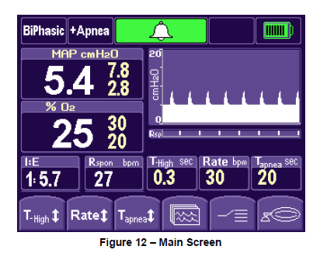

Slide 85
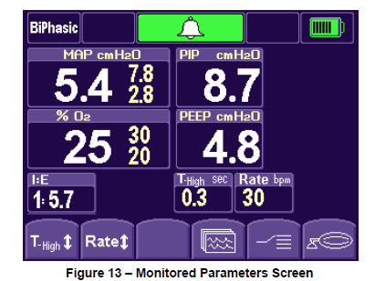

Slide 86
Final Checks
Check for pressure on nose or ears.
Be sure eyes are clearly visible.
Be sure generator is stable and secure.
Check for proper CPAP and Sigh pressures.
Do physical assessment of infant (e.g. vitals, SpO₂, comfort).

Slide 87
Follow-up Care
Hourly:
  Generator should be positioned properly on nose without excess pressure.
  Eyes should be clearly visible.
  Pressure levels should be accurate.

Slide 88
Per Protocol checks
Physical assessment.
    Check nasal and ear skin integrity.
    Adjust infant position.
    Clean skin with water only.
    Suction airway.
Equipment assessment.
    Clean prongs or mask.
    Check humidification and gas temperature.
    Check pressures, FiO₂.

Slide 89
Nursing Care
Maintain OG tube.
Infant may still receive enteral feeding.
Reposition infant.
Maintain infant comfort.

Slide 90
Conventional Ventilation
Drager Babylog VN500

Slide 91
Conventional Ventilation
Intubation
Circuits
Humidification
Indications
Initial set up
Weaning
Discontinuation
VIP Special Features

Slide 92
Intubation
Indications (not necessarily ventilation)
  One minute Apgar 0 to 3.
  Bag & mask ventilation is difficult.
  Thick meconium is present.
  Suspect diaphragmatic hernia.
  Obstructive lesions.
  Secretion removal.
  Surgery.
  Sputum culture.

Slide 93
Intubation - Equipment
Gest. Age weeks | Wgt. In Grams | Uncuffed ET ID mm | Suction Catheter | Blade | Nasal Depth 7-8-9 rule + 1cm | Oral Depth 7-8-9 rule
< 28 | <1000 | 2.5 | 5 | Miller 0 | <8cm | <7cm
28–34 | 1000 - 2000 | 3.0 | 6 | Miller 0 | 1000g 8cm | 1000g 7cm
34-38 | 2000 - 3000 | 3.5 | 6 | Miller 0 | 2000g 9cm | 2000g 8cm
>38 | >3000 | 4.0 | 8 | Miller 0 -1 | 3000g 10cm | 3000g 9cm
ET Tube on X-ray has placement at T2 – T5

Slide 94
Pediatric ET Tube Size (>1yr)
Inside Diameter (mm) =
  16 + age in years
  4
  Uncuffed tubes until age 8 years
Miller blade for infants (straight)
Macintosh for pediatrics (curved)

Slide 95
QUESTION: For the neonate below 1000 gram body weight, the proper size laryngoscope blade should be size _____ and endotracheal tube size ____ ID mm:
0, 1.5
0, 2.5
1, 1.5
1, 2.5
B. 0, 2.5

Slide 96
Circuits
Usually low compliant circuits.
  Minimizes volume loss.
  Lost vol. = Compliance factor x (PIP – PEEP)
No lost volume correction needed if volume measured at proximal airway.
Usually heated wire circuits.
Water traps required if non-heated circuit.

Slide 97
Humidification
Usually low compliance wick style humidifiers.
Monitor for rain-out.
  Adjust wire heat.
  Add traps if not heated.
Recommended temperature at the airway is 32 – 37° C.
Place proximal temperature probe outside isolette or radiant warmer.

Slide 98
Indications for Ventilation
Apnea.
Hypercapnea (PaCO₂ increase with pH decrease).
Hypoxemia (PaO₂ < 50 mmHg on elevated FiO₂).
Decrease WOB.
  Maintain elasticity & FRC.
  Prevent atelectasis.

Slide 99
Initial Ventilator Settings
Mode
Frequency
Peak Pressure
Tidal Volume
Inspiratory Time
I:E Ratio
Flow
FIO2
PEEP

Slide 100
Mode
Neonatal:
  SIMV or AC.
  Time cycled & Pressure limited.
  Volume guaranteed (?).
Pediatric:
  Assist Control.
  Volume ventilation (corrected).

Slide 101
Mode
Newer techniques:
  Flow Synchronized
  Termination sensitivity
  Leak compensation
  Volume measurement
  Graphics
  Pressure support
  Volume ventilation
  Flow variability
  Rise time %

Slide 102
Frequency
Pre-term: 30 – 40 BPM.
Term: 20 – 30.
Pediatric: 8 – 12.
Desired PaCO₂ & PtcCO₂ is 35 – 45 mmHg.
Desired pH is 7.30 – 7.45.
Pulmonary Interstitial Emphysema (PIE) may have higher PaCO₂.

Slide 103
Peak Pressure
Set with:
  Inspiratory pressure limit.
  High pressure relief.
Pressure alarms set at +/- 5 to 10 cm H₂O.
Preterm: set pressure < gestational age.
Term: 20 - 25 cm H₂O.
Decreased Compliance: 25 – 30 cm H₂O.
Pediatric: Variable to get tidal volume desired.

Slide 104
Tidal Volume
Neonate:
  Preterm: 4-6 mL/kg.
  Term: 5-8 mL/kg.
  Decreased compliance: <5 mL/kg.
  Pediatric: 5-8 mL/kg.
  Vt. (L) = Ti (sec) x flow (L/sec)

Slide 105
Vt. = T_{i} (sec) x flow (L/min)
  Vt. = T_{i} (sec) x flow (mL/60 sec)
  EXAMPLE: T_{i} 0.4 and flow 6,000 mL/60 sec
1. Convert: 6000 mL/60 sec = 100 mL/sec
2. Solve: 0.4 sec x 100 mL/sec = 40 mL

Slide 106

Inspiratory Time
Pre-term: 0.25 – 0.5 sec.
Term: 0.5 - 0.6 sec.
Pediatric: - 0.6 – 0.8 sec.
Non-compliant lung: May be longer to increase MAP & I:E Ratio.

Slide 107
I:E Ratio
Pre-term: 1:1.5 – 1:4.
Term: 1:3 or 1:4.
Pediatric: 1:2.
Non-compliant lung: 1:1 or more as needed for oxygenation.
Proper T_{i} and rate = appropriate I:E.

Slide 108
Flow
Pre-term to Pediatrics: 5 - 10 L/min
Flow = V_{t} (L) / T_{i} x 60
To calculate approximate V_{t} = Insp. time (sec) x flow (L/min.)

Slide 109
FiO₂
Normal Lung: Set per clinical appearance, SpO₂, PtcO₂.
Non-compliant lung: Set per clinical appearance, SpO₂, PtcO₂ and capillary PO₂. Consider PEEP increase as FiO₂ approaches 0.6.
  Maintain PaO₂ >50 mmHg.
  Higher PaO₂ needed with increased PVR.
  Use PEEP if FiO₂ >/= 0.6.
  Capillary PO₂ does not correlate and cannot be relied on.

Slide 110
PEEP
Pre-term to Pediatric = 3 - 5 cm H₂O.
Non-compliant lung: up to 8 cm H₂O to start.

Slide 111
Weaning
TC/PL-AC:
  Decrease rate until infant is triggering all breaths.
  Decrease FiO₂ and PEEP as tolerated.
  Decrease PIP as tolerated.
  Extubate.
TC/PL-SIMV
  Decrease PIP, FiO₂ & PEEP as tolerated.
  Turn off Termination Sensitivity (if available).
  Decrease rate as tolerated.
  Extubate when rate < 5 bpm.

Slide 112
Weaning
VC-SIMV
  Decrease V_{t}, FiO₂ and PEEP as tolerated.
  Decrease rate.
  Use PS as needed.
  Extubate when rate zero and PS < 10 cm H₂O.
Pressure Support
  Turn off rate.
  Titrate PS to desired V_{t} and rate.
  Wean to PS < 10 cm H₂O as tolerated.
  Extubate.
CPAP Trial

Slide 113
Discontinuation
Exhalation block, diaphragm and non-disposable adapters - washed then cidexed or pasteurized.
Temperature probes – gas sterilized.
Ventilator – clean with alcohol-soaked cloth.
Flow sensor – Klenzyme soak, sterile water rinse, 5L/min gas purge to dry the gas sterilize.

Slide 114
HFOV
Controls for Improving Oxygenation:
  Increased FiO₂.
  Increased MAP.
  Increased Bias flow.
  Decreased Frequency.

Slide 115
HFOV
Controls for Improving Ventilation:
  Increase Amplitude.
  Increase % Inspiratory Time.
  Decrease frequency (Hz).
  Remove air from ET cuff to create small leak.

Slide 116
HFOV
http://www.youtube.com/watch?v=bYyXOrZlN2c
http://www.youtube.com/watch?v=p-Y1tZgCuTk
http://www.youtube.com/watch?v=T-d35aEc2-k
http://www.youtube.com/watch?v=UgaDa4jNYP0
http://www.youtube.com/watch?v=BWFHM3gX3JQ

